Slide 1

Representing complex situations
Aaron Steven White
University of Rochester
Colloquium Talk
University of Texas at Austin
10 November 2023

Slide 2
What we do
We use natural language to convey information about situations: things that happen or stuff that is true.

Slide 3
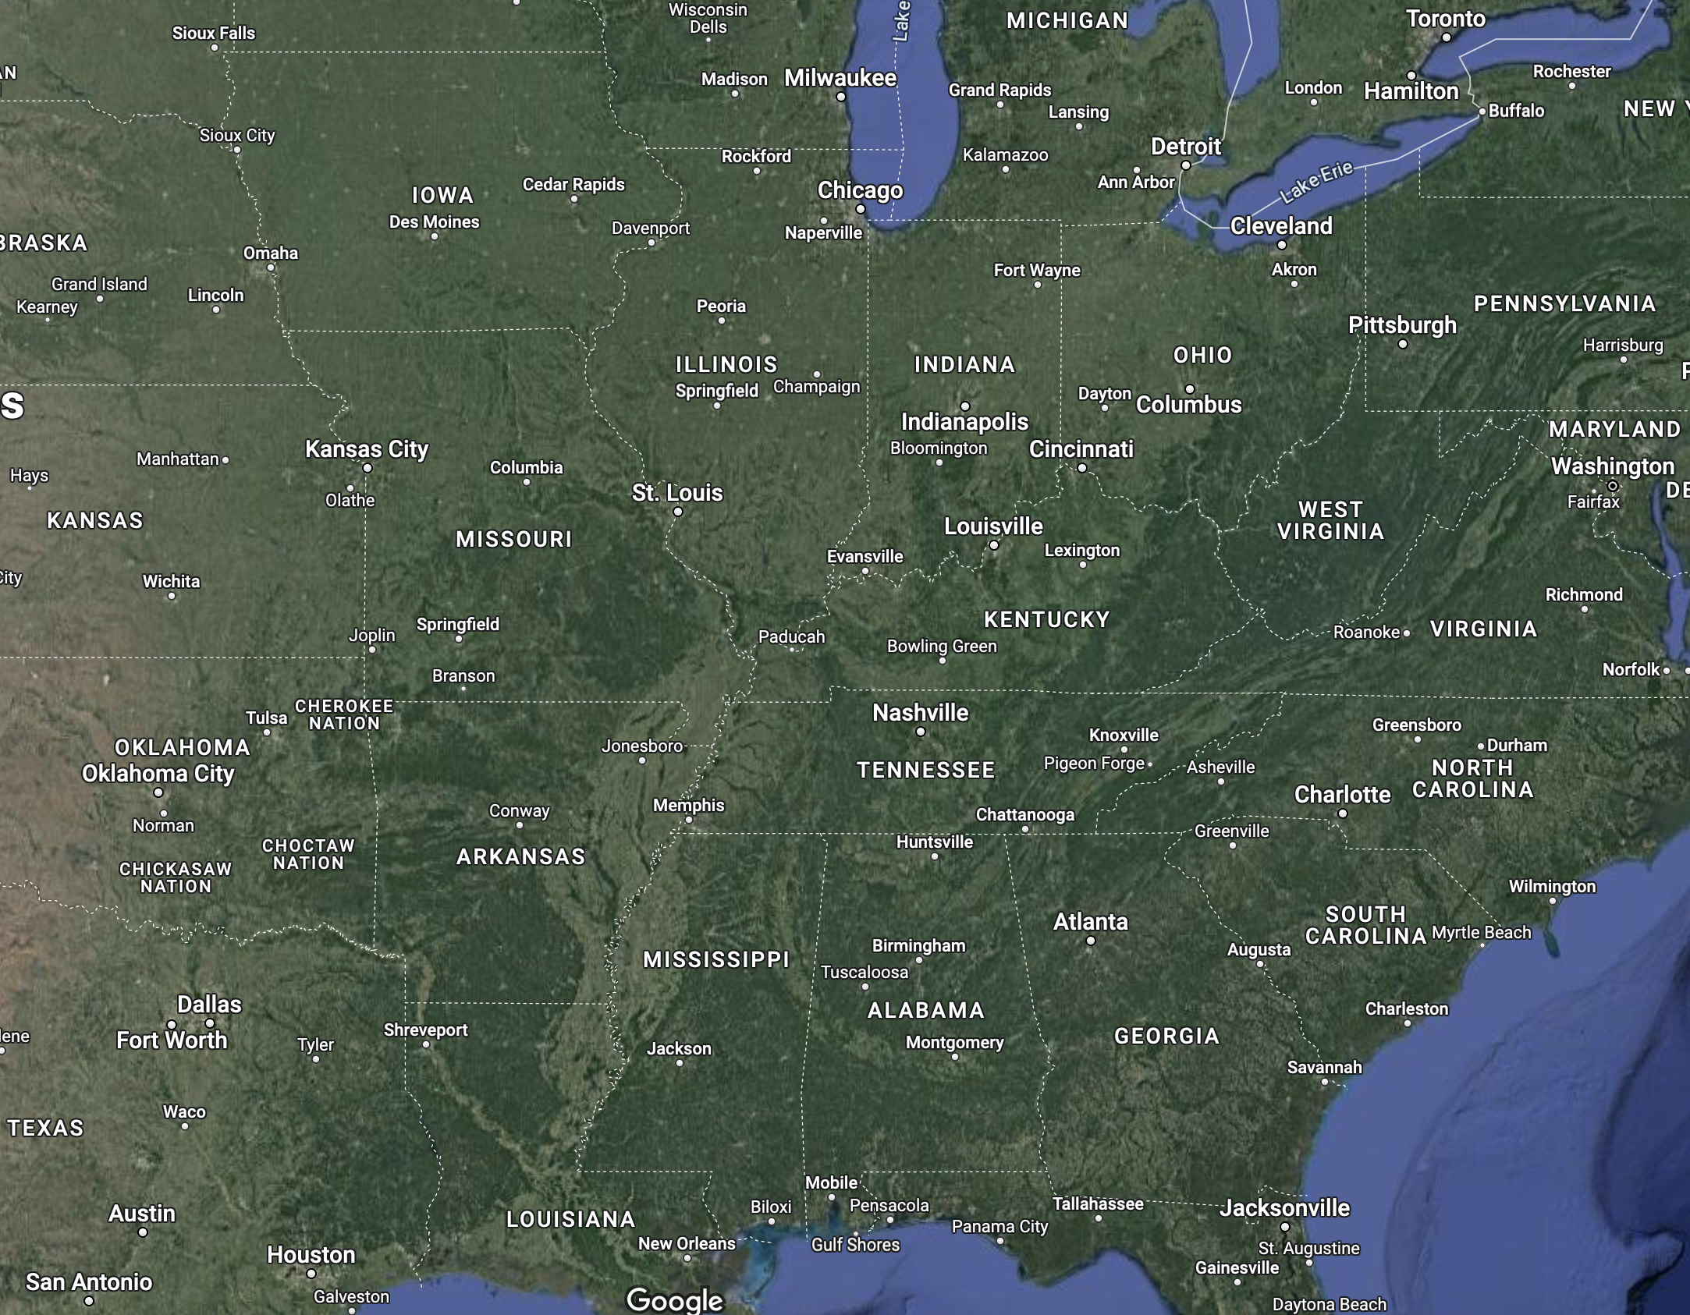
I traveled from Rochester to Austin yesterday.

Slide 4
What we do
We use natural language to convey information about situations: things that happen or stuff that is true.
How we do this
Systematic relationships between the way we conceptualize situations and the way we describe them.

Slide 5
I traveled from Rochester to Austin yesterday.

Slide 6
What we do
We use natural language to convey information about situations: things that happen or stuff that is true.
How we do this
Systematic relationships between the way we conceptualize situations and the way we describe them.
What this allows us to do
Draw inferences that go beyond what one strictly says in describing a situation.

Slide 7
I traveled from Rochester to Austin yesterday.
Aaron was in Rochester yesterday.
Aaron was in Austin yesterday.
Aaron was in Rochester before he was in Austin.
Aaron changed location over the course of the travel.

Slide 8
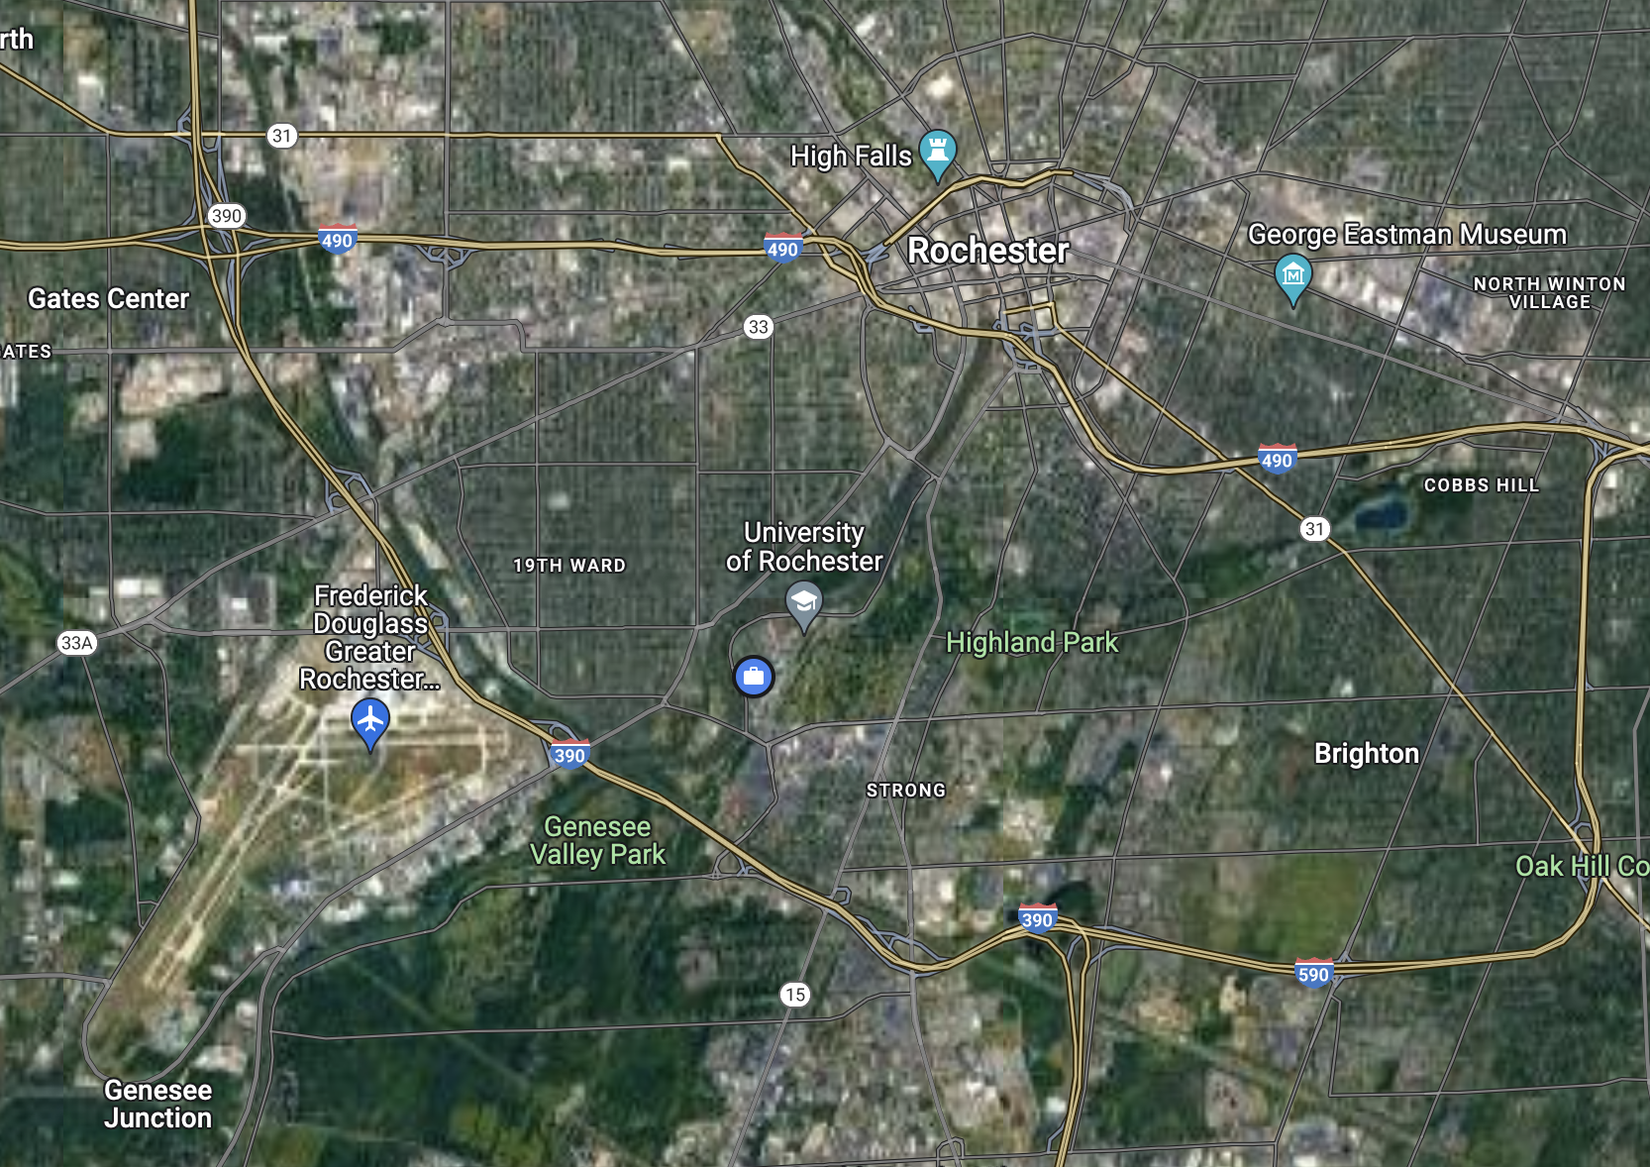

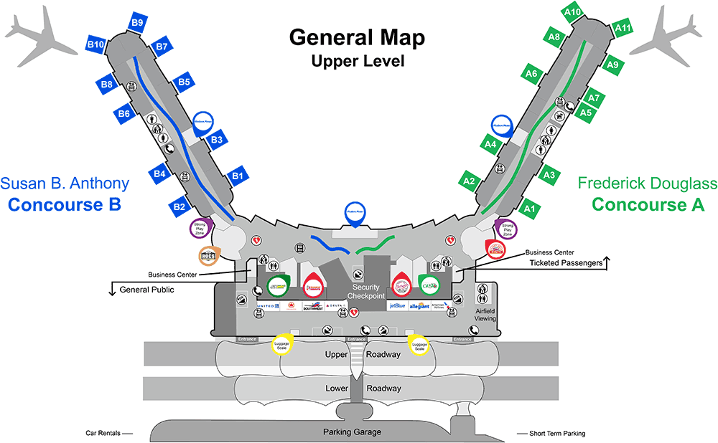
I traveled from Rochester to Austin yesterday.
Aaron took a flight yesterday.
Aaron traveled to the Rochester airport yesterday.
Aaron went through airport security at the Rochester airport yesterday.

Slide 9
Question
How do we design systems that capture the inferences we draw about situations based on their descriptions?
Ontology-factored approach
Map situation description to symbolic situation ontology and draw inferences using rules stated over that ontology.

Slide 10
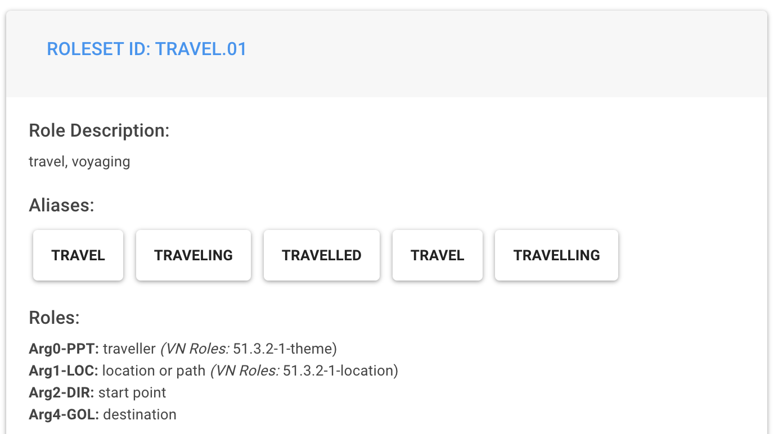
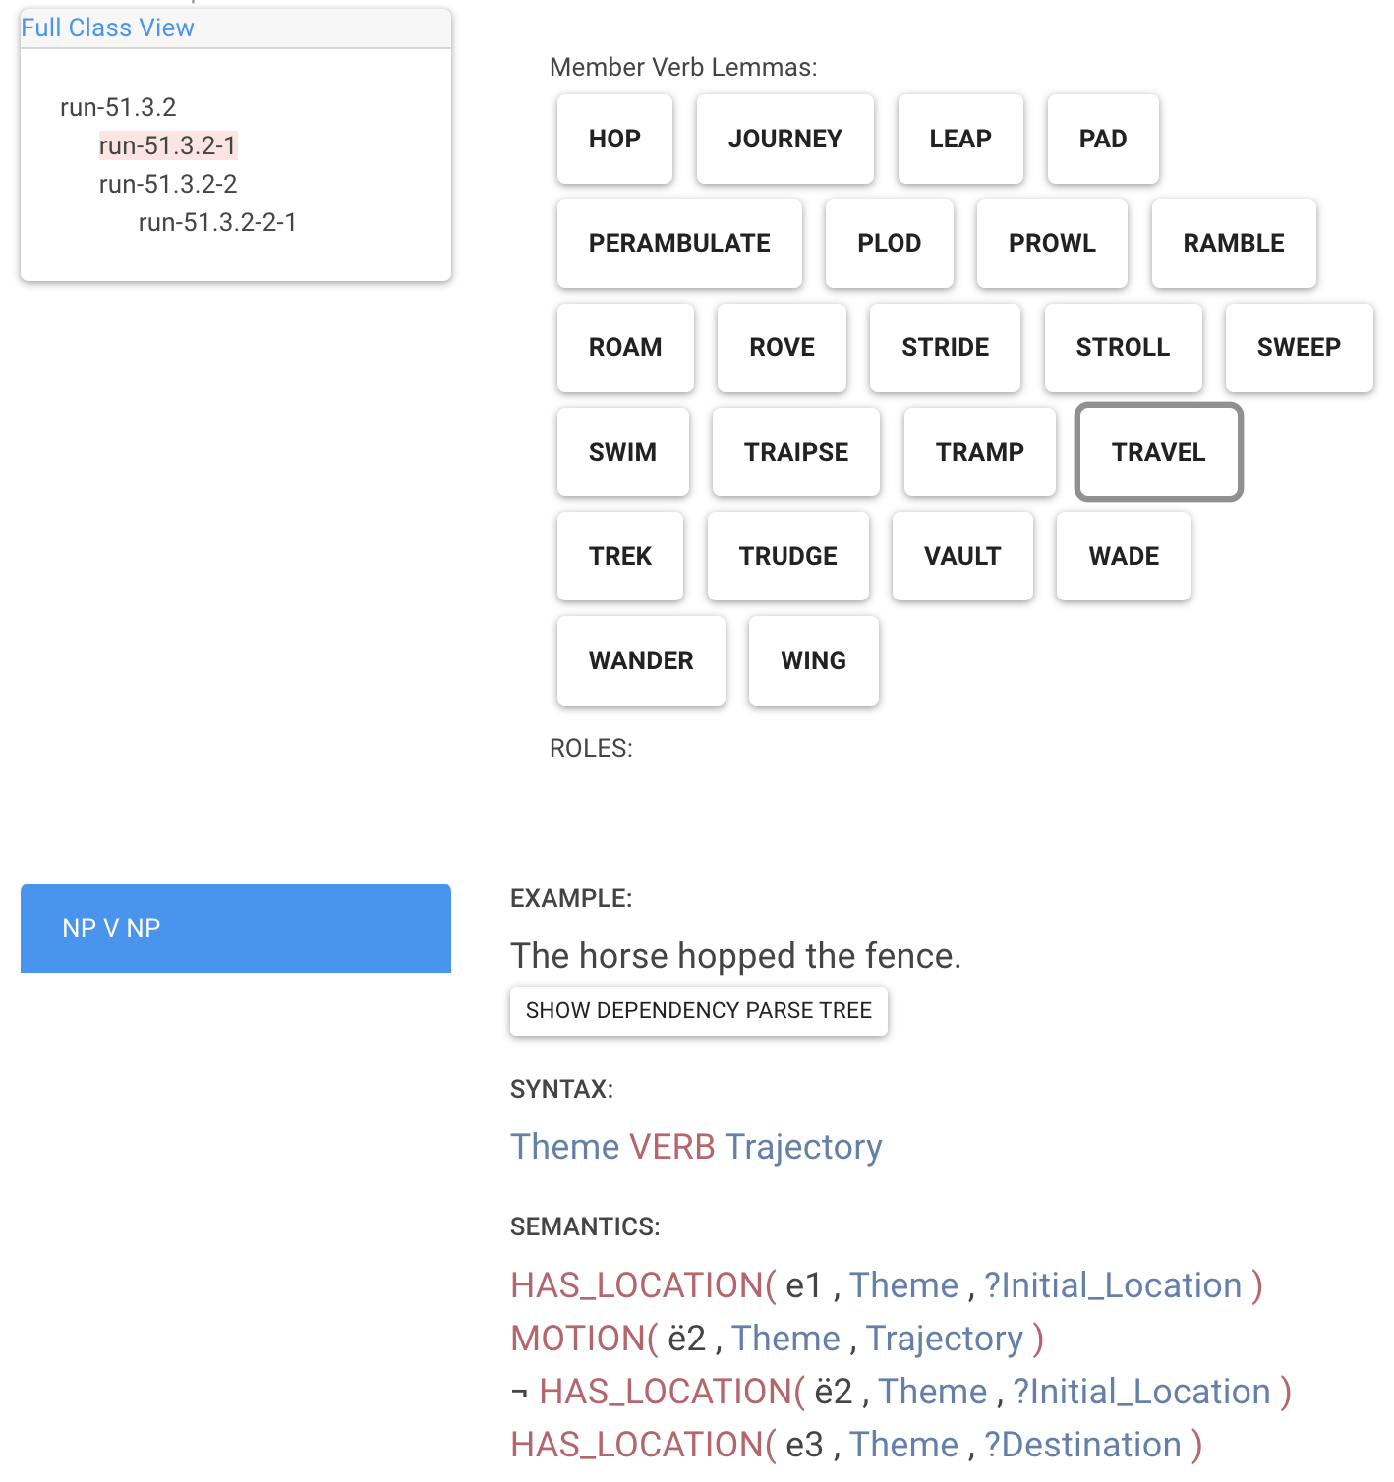
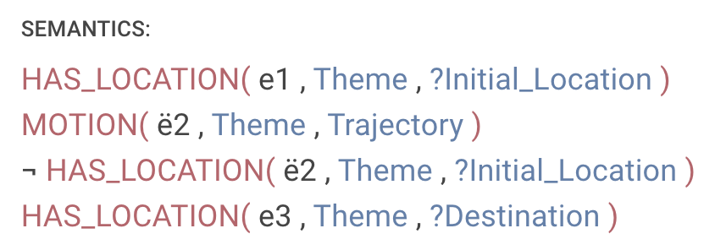
I traveled from Rochester to Austin yesterday.
Uniform Meaning
Representation
Van Gysel et al. 2021
PropBank
Palmer et al. 2005
travel-01
temporal
yesterday
PARTICIPANT0
PARTICIPANT2
PARTICIPANT4
aspect
VerbNet
Kipper-Schuler 2005
process
person
region
region
ref-person
name
name
1st
ref-number
Rochester
singular
Austin
Aaron was in Rochester yesterday.

Slide 11
Challenge #1: Expense
Ontologies and annotated corpora are expensive to build and maintain because they require highly trained experts.
Challenge #2: Brittleness
Ontologies do not easily capture the ways in which context modulates the inferences that we draw.

Slide 12
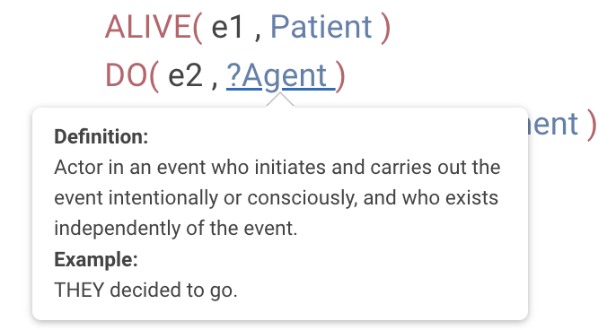
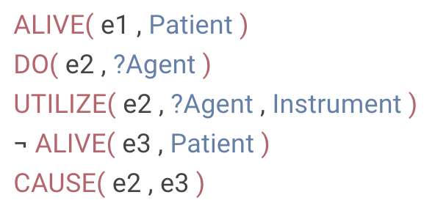
An assassin in Colombia killed a federal judge on a Medellin street.
The antibody then kills the cell.
She was untrained and, in one botched job, killed a client.
x
?
The assassin chose to be involved in killing the judge.
The antibody chose to be involved in killing the cell.
She chose to be involved in killing the client.
Reisinger et al. 2015

Slide 13
Question
How do we design systems that capture the inferences we draw about situations based on their descriptions?
Ontology-factored approach
Map situation description to symbolic situation ontology and draw inferences using rules stated over that ontology.
Ontology-free approach
Map situation descriptions to natural language strings expressing the inferences of interest.

Slide 14
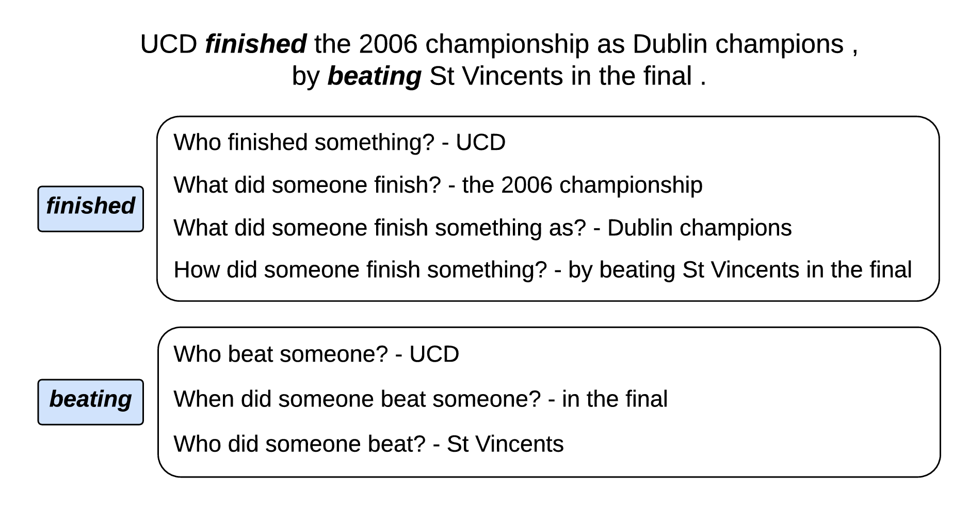
QA-SRL/QAMR
He et al. 2015, Michael et al. 2018

Slide 15
Challenge: Lack of Abstraction
Not clear how to determine an interesting set of inferences with which to represent a situation.

Slide 16
Ontologies as Representational Scaffolding
Ontologies provide guidance about what the interesting, more abstract inferences are.
These more abstract inferences are directly associated with a text, as in ontology-free approaches.

Slide 17
Challenge: Inferential Coverage
How do we ensure that we capture inferences at varying levels of granularity?

Slide 18
I traveled from Rochester to Austin yesterday.
More abstract
Broader coverage
Aaron was in Rochester yesterday.
Aaron was in Austin yesterday.
Aaron was in Rochester before he was in Austin.
Aaron changed location over the course of the travel.
More concrete
Narrower coverage
Aaron took a flight yesterday.
Aaron traveled to the Rochester airport yesterday.
Aaron went through airport security at the Rochester airport yesterday.

Slide 19
Part 1: Light Scaffolding
Highly abstract ontologies as light scaffolding for building sets of broadly applicable inference templates.

Slide 20
An assassin in Colombia killed a federal judge on a Medellin street.
The antibody then kills the cell.
She was untrained and, in one botched job, killed a client.
x
?
Participant
Participant
Participant
The assassin chose to be involved in killing the judge.
The antibody chose to be involved in killing the cell.
She chose to be involved in killing the client.
Situation
Situation
Situation
Reisinger et al. 2015

Slide 21
Part 1: Light Scaffolding
Highly abstract ontologies as light scaffolding for building sets of broadly applicable inference templates.
Part 2: Heavy Scaffolding
More concrete ontologies as heavy scaffolding for building sets of more targeted inference templates.

Slide 22
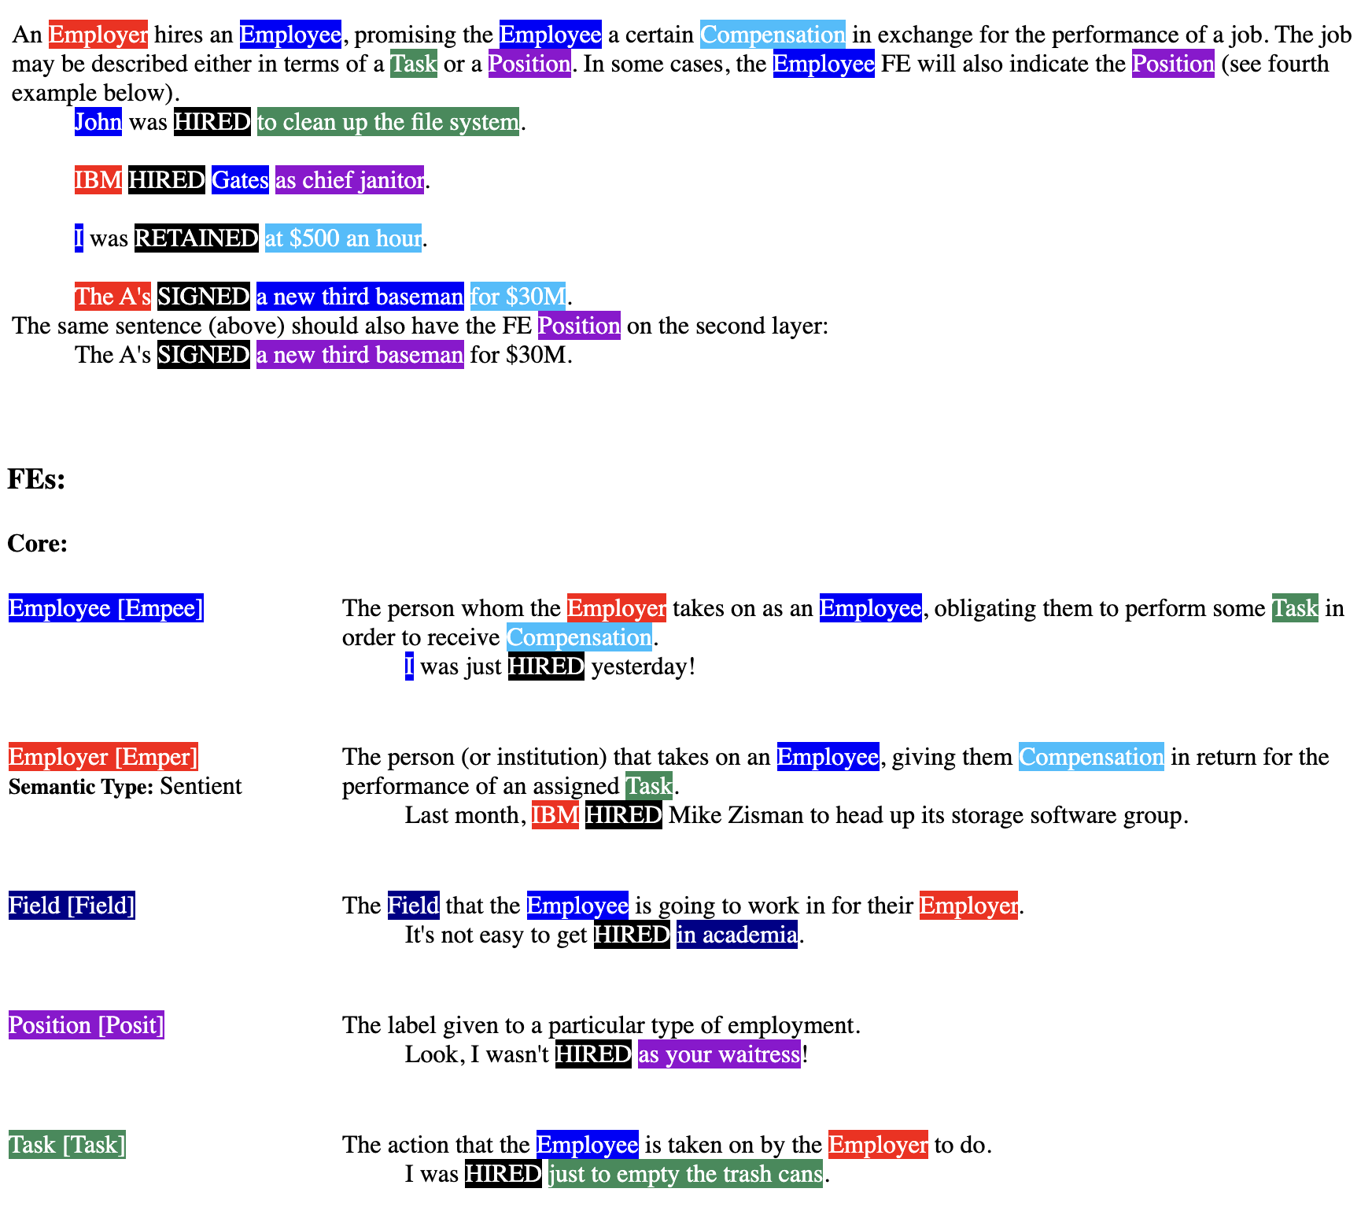
FrameNet Baker et al. 1998
Transitive_action
Intentionally_act
inheritance
inheritance
Employment_scenario
Intentionally_affect
subframe
perspective on
inheritance
Employment_start
Employment_continue
Employment_end
Employer_scenario
perspective on
precedes
precedes
Get_a_job
Being_employed
Quitting
precedes
precedes
subframe
subframe
subframe
Hiring
Employing
Firing
precedes
precedes

Slide 23
Disclaimer
I do not intend to make claims about human cognition anywhere in this talk.
Goal
Laying out a program for how to build representations of complex situations balancing expressivity and flexibility.

Slide 24
Light Scaffolding

Slide 25
Goal
Find a set of inference templates that are both interesting and broadly applicable across many situations.

Slide 26
Idea
Inferences relevant to mapping from concepts to linguistic structure tend to be inferences humans really care about.
Example #1: Linking Theory
PARTICIPANT₁
SUBJECT
SITUATION
PARTICIPANT₂
PREDICATE
OBJECT
PARTICIPANT₃
OBLIQUE
concept
structure

Slide 27
Light Scaffolding
Participant relations

Slide 28
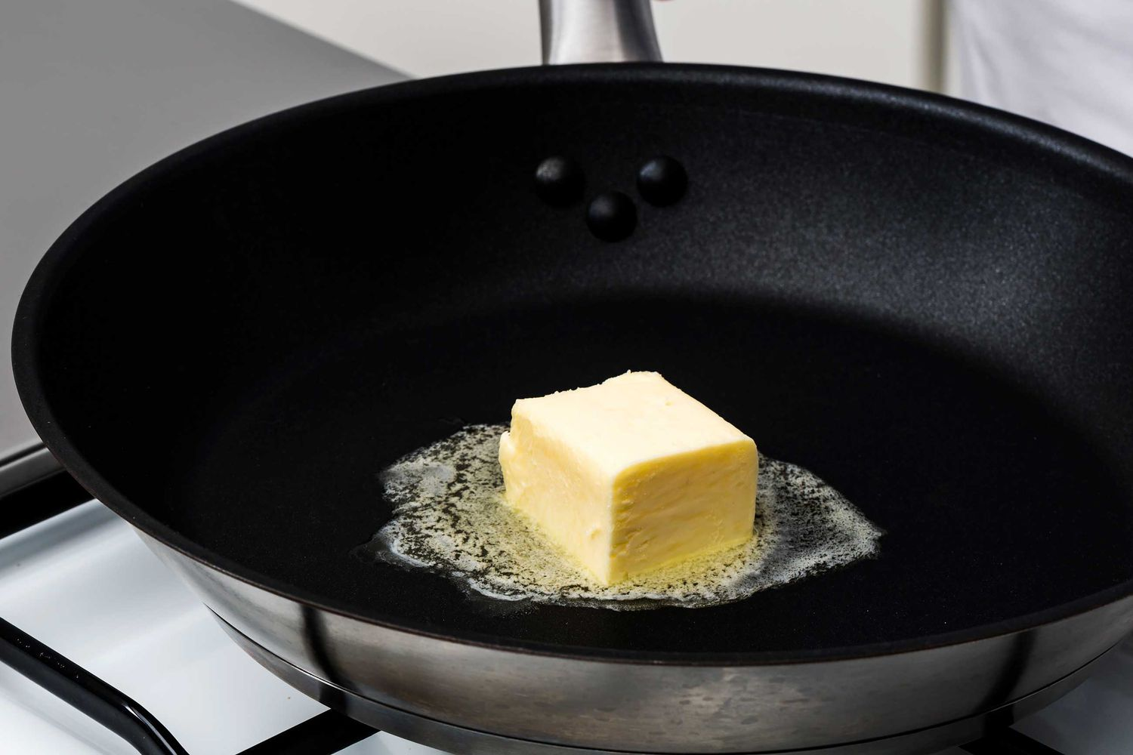
MELT
MELTER
MELTEE
MELT-WITH
The chef melted the butter.
The butter melted.
The chef melted the butter with a steady low heat.
A steady low heat melted the butter.
The butter melted the chef.
???
Fillmore 1970, Levin 1993

Slide 29
MELT
MELTER
MELTEE
MELT-WITH
AGENT
PATIENT
INSTRUMENT
subject
subject
object
object
oblique
subject
subject
object
subject
object
The chef melted the butter with a steady low heat.
A steady low heat melted the butter.
The butter melted the chef.
The chef melted the butter.
The butter melted.
Fillmore 1970, Levin 1993

Slide 30
MELT
MELTER
MELTEE
MELT-WITH
AGENT
PATIENT
INSTRUMENT
MELTER is volitional in MELT.
MELTEE changes in MELT.
MELT-WITH is used to MELT.
Dowty 1991

Slide 31
Dowty’s idea
Having more prototypically agentive properties compared to other roles makes a role more likely to map to SUBJ.
Upshot
Inferences relevant to linking theory are probably ones humans tend to care a lot about.

Slide 32
PARTICIPANT chose to be involved in SITUATION.
PARTICIPANT caused SITUATION to happen.
Protoagent
PARTICIPANT was aware of being involved in SITUATION.
PARTICIPANT changed location during SITUATION.
PARTICIPANT existed before SITUATION began.
PARTICIPANT existed during SITUATION.
PARTICIPANT existed after SITUATION stopped.
PARTICIPANT changed possession during SITUATION.
PARTICIPANT was used in carrying out SITUATION.
PARTICIPANT was changed or somehow altered during or by the end of SITUATION.
Protopatient
SITUATION happened for the benefit of PARTICIPANT.
The change in PARTICIPANT happened throughout the SITUATION.
Only a part or portion of PARTICIPANT was involved in SITUATION.
Dowty 1991, Reisinger et al. 2015, White et al. 2016

Slide 33
Two steps
Find relevant SITUATION-PARTICIPANT pairs.

Slide 34
PARTICIPANT chose to be involved in SITUATION.
Hiller chose to be involved in the asking.
Bush chose to be involved in the asking.
White et al. 2016, 2020, Zhang et al. 2017

Slide 35
Two steps
Find relevant SITUATION-PARTICIPANT pairs.
Requirement
Very light scaffolding ontology including at least SITUATION, PARTICIPANT, and RELATION.

Slide 36
relation
participant
situation
Similar to OpenIE
Banko et al. 2007
White et al. 2016, 2020, Zhang et al. 2017

Slide 37
relation
event
participant

Slide 38
Rule-based approach
White et al. 2016, Zhang et al. 2017
based on Rudinger and Van Durme 2014
A set of rules defined on top of Universal Dependencies syntactic annotations.
Transductive parsing approach
Stengel-Eskin 2020, 2021
based on Zhang et al. 2019
Encoder-decoder networks that take raw sentence and produce semantic graph on the decoder side.

Slide 39
Two steps
Find relevant SITUATION-PARTICIPANT pairs.
Figure out which inferences hold of which pairs.
Requirement
Very light scaffolding ontology including at least SITUATION, PARTICIPANT, and RELATION.

Slide 40
PARTICIPANT chose to be involved in SITUATION.
Hiller chose to be involved in the asking.
Bush chose to be involved in the asking.
White et al. 2016, 2020, Zhang et al. 2017

Slide 41
Hiller asked Bush to name the leaders of Chechnya, Taiwan, India, and Pakistan.
How likely is it that Hiller chose to be involved in the asking?
very unlikely
somewhat unlikely
not enough information
somewhat likely
very likely
Reisinger et al. 2015, White et al. 2016, 2020, Zhang et al. 2017

Slide 42
Hiller asked Bush to name the leaders of Chechnya, Taiwan, India, and Pakistan.
How likely is it that Bush chose to be involved in the asking?
very unlikely
somewhat unlikely
not enough information
somewhat likely
very likely

Slide 43
Data
~10k predicate-argument pairs from Penn TreeBank +
~6k predicate-argument pairs from Universal Dependencies English Web Treebank.

Slide 44
Question
How well can we predict these inferences using models trained on general natural language inference datasets?
Approach
White et al. 2017
Train model on SNLI v. our data and test on our data.

Slide 45
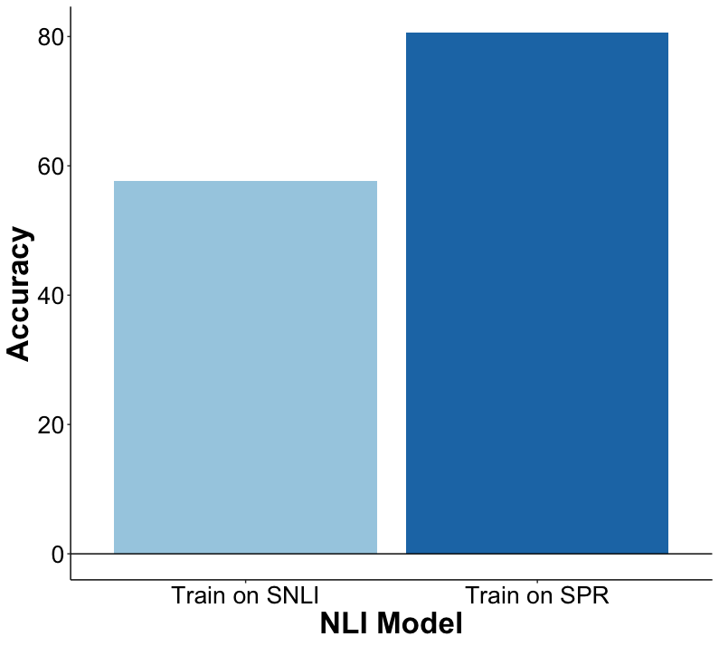
White et al. 2017

Slide 46
Upshot
We don’t get these properties for free from general purpose models.

Slide 47
Challenge
Light scaffolding is currently sentence-bound, meaning it’s hard to capture information about complex situations.
Approach
White et al. 2017
Augment light scaffolding with cross-sentential relations and construct inference templates for those relations.

Slide 48
Idea
Inferences relevant to mapping from concepts to linguistic structure tend to be inferences humans really care about.
Example #2: Event Structure
SUBSITUATION₁
CLAUSE₁
PREDICATE
SITUATION
SUBSITUATION₂
CLAUSE₂
CONTAINER
SUBSITUATION₃
CLAUSE₃
concept
structure

Slide 49
Light Scaffolding
Situation relations

Slide 50
The chef began to make the roux.
ROUX-MAKING
Before adding the flour, she melted the butter.
Making the roux took some amount of time.
Adding the flour was part of making the roux.
Melting the butter ended before adding the flour started.

Slide 51
Idea #1
Vendler 1957
Situations fall into classes based on their temporal progression.
Idea #2
These classes can be decomposed in terms of the inferences they trigger about their temporal progression and the relations among their subevents.
Kenny 1963, Lakoff 1965, Verkuyl 1972, Bennett and Partee 1978, Mourelatos 1978, Dowty 1979, Jackendoff 1990, Pustejovsky 1995, i.a.

Slide 52
The chef began to make the roux. Before adding the flour, she melted the butter. While she gently stirred the mixture, one of her sous chefs cracked an egg. The other stood and watched.
The melting took some amount of time.
The stirring took some amount of time.
The cracking was instantaneous.
The standing took some amount of time.

Slide 53
The chef began to make the roux. Before adding the flour, she melted the butter. While she gently stirred the mixture, one of her sous chefs cracked an egg. The other stood and watched.
The melting had a natural endpoint.
The cracking had a natural endpoint.

Slide 54
The chef began to make the roux. Before adding the flour, she melted the butter. While she gently stirred the mixture, one of her sous chefs cracked an egg. The other stood and watched.
The melting was dynamic.
The stirring was dynamic.
The cracking was dynamic.

Slide 55
SITUATION lasted TIME-UNIT.
SITUATION was dynamic.
Event internal
SITUATION had natural parts.
Parts of SITUATION are similar to each other.
Parts of SITUATION lasted TIME-UNIT on average.
Event mereology
SITUATION1 was part of SITUATION2.
SITUATION2 was part of SITUATION1.
SITUATION1 started before SITUATION2 started.
Temporal relations
SITUATION1 ended before SITUATION2 started.
SITUATION1 started before SITUATION2 ended.
SITUATION1 ended before SITUATION2 ended.
Govindarajan et al. 2019, Vashishtha et al. 2019, 2020, Gantt et al. 2022

Slide 56
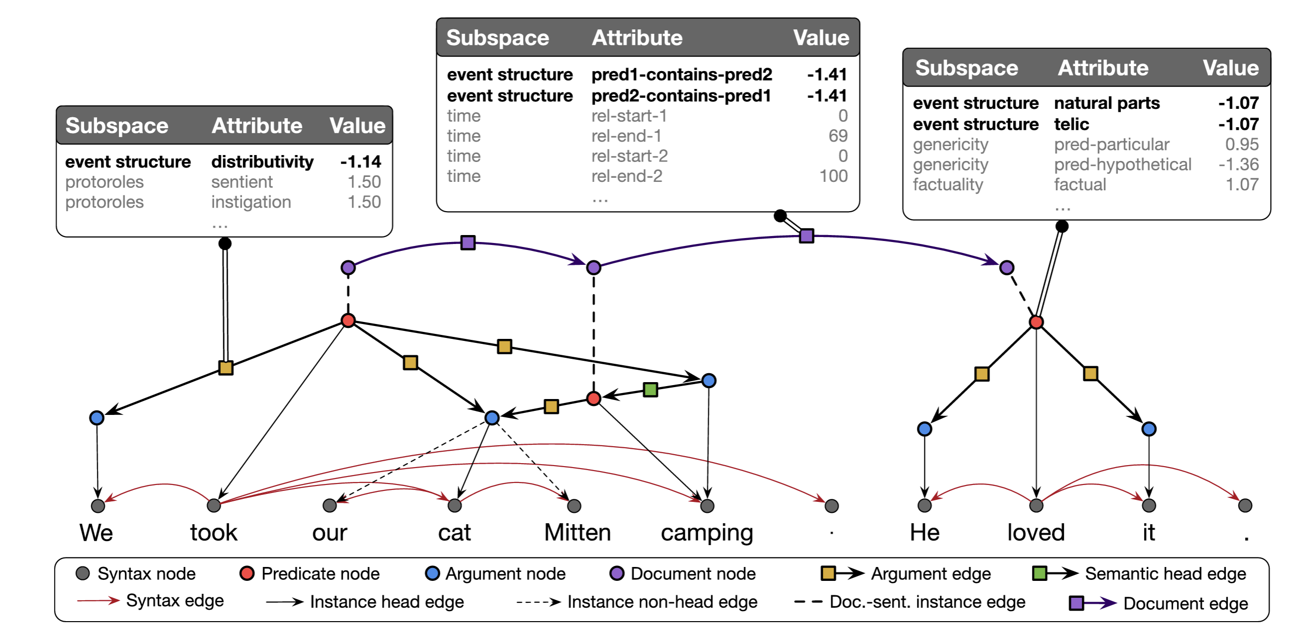

Slide 57
Data
~32k predicates from UD-EWT for
~70k predicate-predicate pairs from UD-EWT

Slide 58
Question
How well can we predict these inferences using models trained on general natural language inference datasets?
Approach
Vashishtha et al. 2020
Train model on MNLI v. our data and test on our data, focusing specifically on temporal duration and relations.

Slide 59
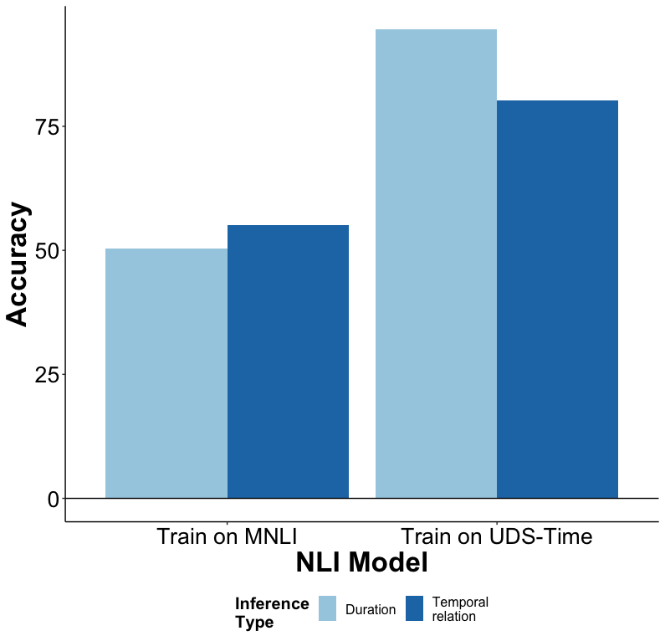
Vashishtha et al. 2020

Slide 60
Upshot
We don’t get these properties for free from general purpose models.
And again based on preliminary results from prompting Llama2 and GPT, this remains true. You need fine-tuning.

Slide 61
Light Scaffolding
Interim Discussion

Slide 62
Goal
Find a set of inference templates that are both interesting and broadly applicable across many situations.

Slide 63
Challenge
Not all situation descriptions are anchored by a predicate; yet, we can draw inferences about that situation.

Slide 64
She melted the butter, then added the flour and stirred the mixture gently.
ROUX-MAKING

Slide 66
Challenge
Not all situation descriptions are anchored by a predicate; yet, we can draw inferences about that situation.
Approach
Lift the requirement that a situation needs to be anchored by a predicate.

Slide 67
Task
Generalized template extraction
Similar to
Event argument extraction, which extends semantic role labeling from the sentence level to the document level.

Slide 68
She melted the butter. Then, she added the flour. And finally, she stirred the mixture gently.
Template 2: MELT
MELTER: {“She”}
MELTEE: {“the butter”}
HEATING-SURFACE: NULL
HEATING-METHOD: NULL
Template 1: MAKE-ROUX
MAKER: {“She”}
FAT: {“the butter”}
THICKENER: {“the flour”}
ROUX: {“the mixture”}
HEATING-SURFACE: NULL
HEATING-METHOD: NULL
STIRRING-IMPLEMENT: NULL
Template 3: MIX
MIXER: {“She”}
MIXING-IMPLEMENT: NULL
INGREDIENTS: {“the butter”, “the flour”}
RESULT: {“the mixture”}

Slide 69
Heavy Scaffolding

Slide 70
Goal
Develop more targeted inference templates using more concrete ontologies.

Slide 71
FrameNet Baker et al. 1998
Transitive_action
Intentionally_act
inheritance
inheritance
Employment_scenario
Intentionally_affect
subframe
perspective on
inheritance
Employment_start
Employment_continue
Employment_end
Employer_scenario
perspective on
precedes
precedes
Get_a_job
Being_employed
Quitting
precedes
precedes
subframe
subframe
subframe
Hiring
Employing
Firing
precedes
precedes

Slide 72
Goal
Develop more targeted inference templates using more concrete ontologies.
Idea
Datasets annotated with broad-coverage ontologies provide guidance about candidate inferences.

Slide 73
Challenge #1
We don’t quite have the perfect dataset for generating these sorts of candidate inferences at scale.
Datasets annotated with broad-coverage ontologies* tend to be annotated at the sentence level.
Datasets annotated at the document-level tend to be annotated with narrow ontologies.
*that anchor to the text and have the sorts of rich glosses we need

Slide 74
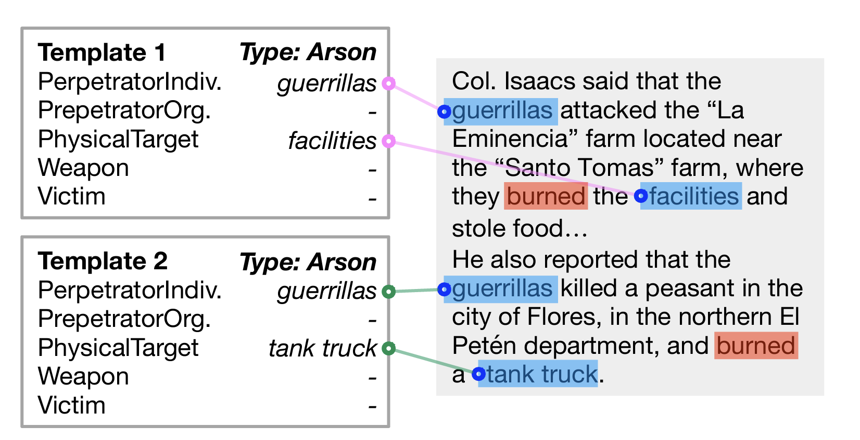
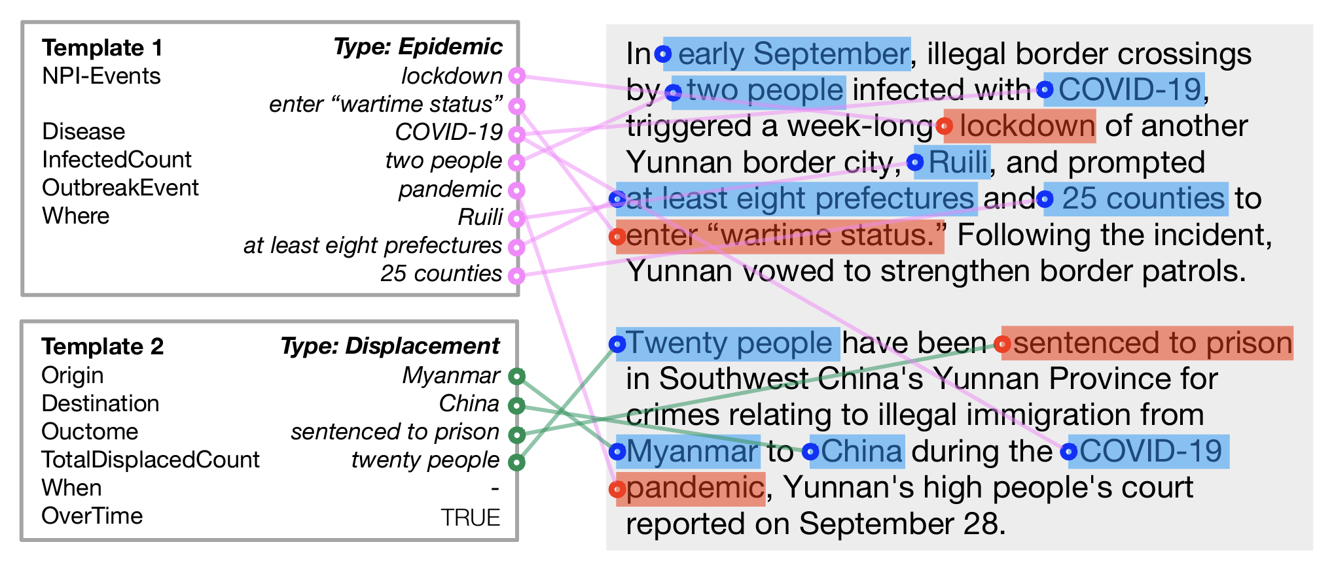
MUC-4 Ontology
arson
attack
bombing
kidnapping
murder
robbery
IARPA BETTER Granular Ontology
incidents of corruption
natural disasters
human migration events
disease outbreaks or epidemics
protests or demonstrations
acts of terrorism
Chen et al. 2023

Slide 75
Challenge #2
Even for datasets annotated with highly constrained ontologies, it is hard to predict templates.

Slide 76
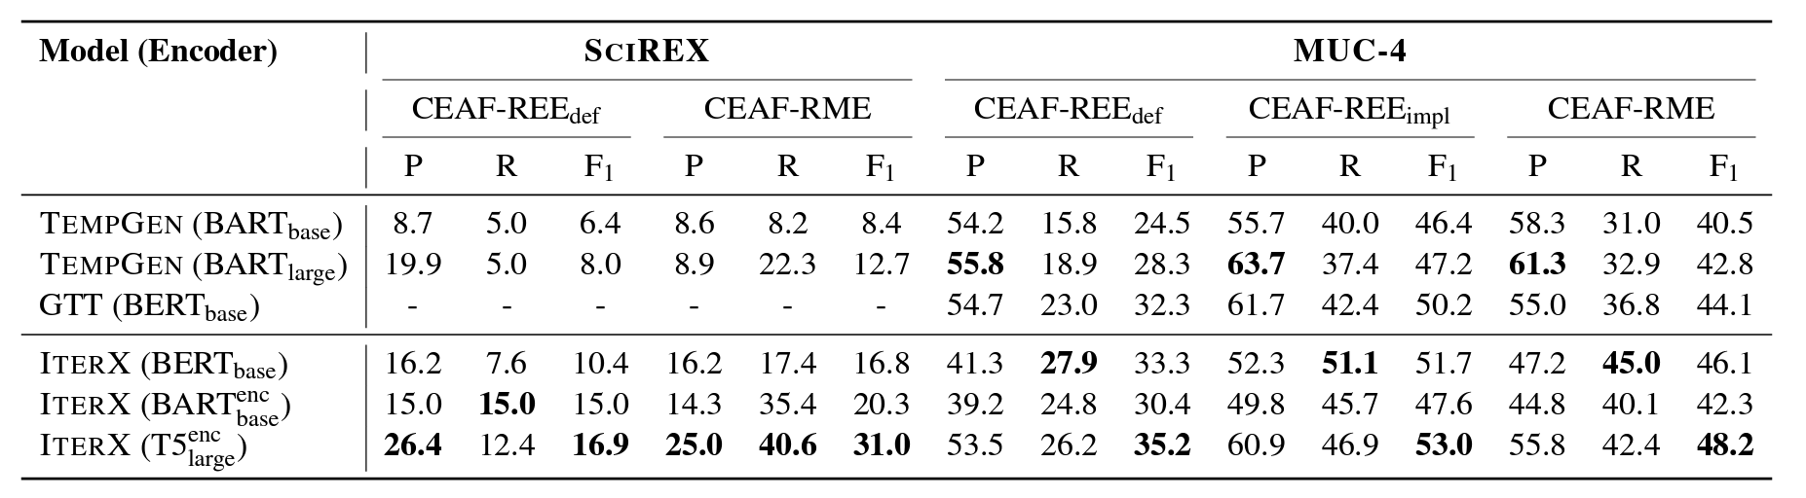
This is a hard task!
Chen et al. 2023

Slide 77
Challenge #2
Even for datasets annotated with highly constrained ontologies, it is hard to predict templates.
Upshot
We need to work on getting template extraction systems working on broad-coverage ontologies before we start using them to generate candidate inferences.

Slide 78
Subgoal #1
Develop a broad-coverage dataset for generalized template extraction.
Subgoal #2
Provide some baseline models for predicting those data.

Slide 79

Fully client-side react-based tool using the concrete data model. Ferraro et al. 2014
Supports situation and entity mention and coreference annotation.
Available at: https://github.com/connotate/connotate

Slide 80
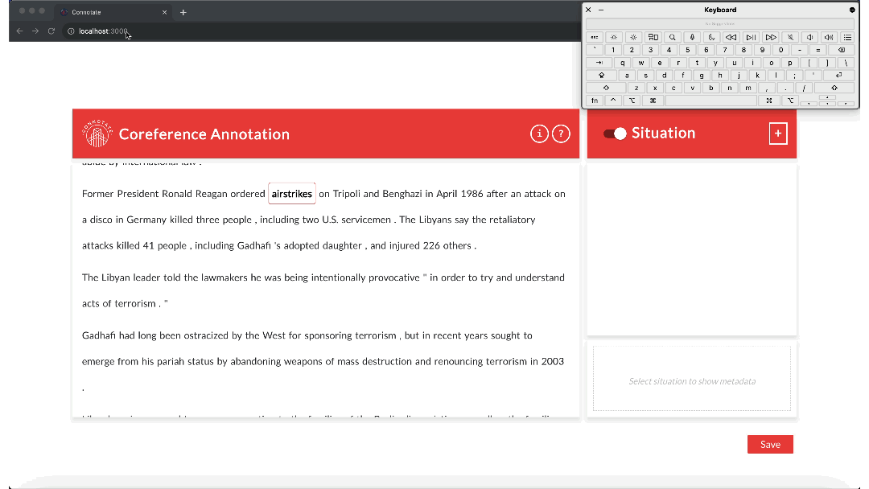
Demo: https://connotate.netlify.app/

Slide 81
Heavy Scaffolding
Event individuation

Slide 82
Challenge
Difficult for annotators to agree on how many instances of a particular complex situation type are described by text.

Slide 83
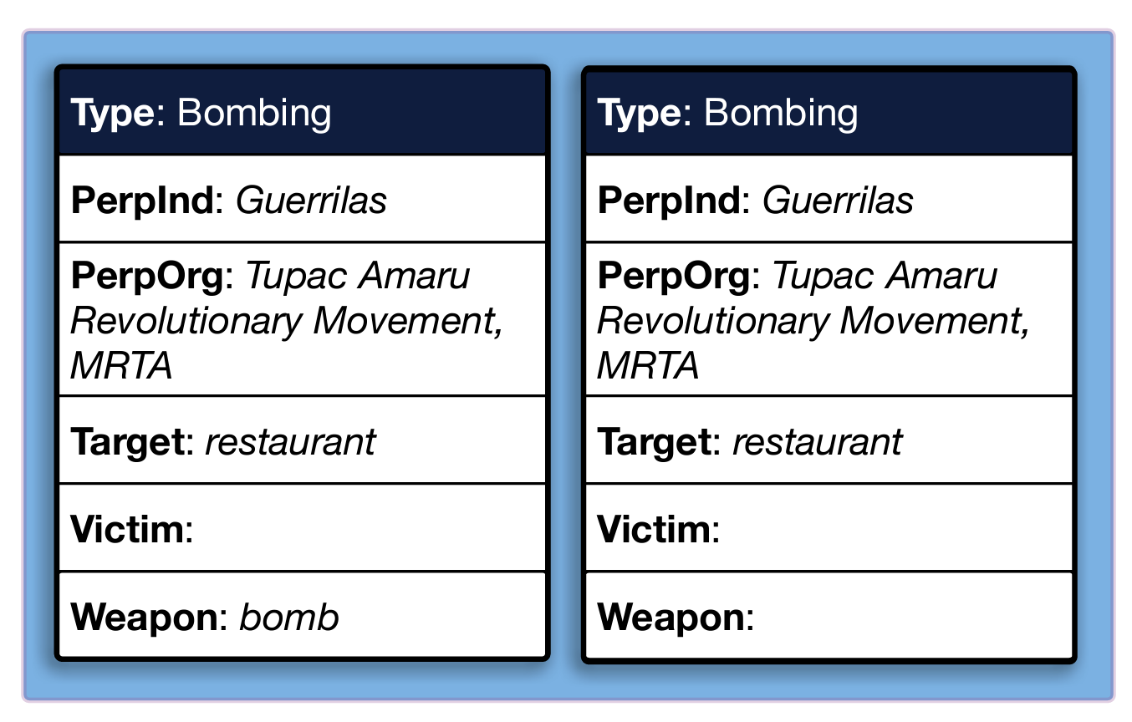
A bomb exploded today in a Lima restaurant, and a second device that had been placed in the same establishment was deactivated by the Peruvian National Police. There were no victims, and the explosion caused very little damage to the restaurant…Guerrillas of the Tupac Amaru Revolutionary Movement (MRTA) have claimed credit for the terrorist act….
Gantt et al. 2023

Slide 84
Approach
Have three experts reannotate portions of the MUC-4 and BETTER data for number of instances of a template.
Evaluation
Compare agreement among experts annotations and with gold annotation.

Slide 85
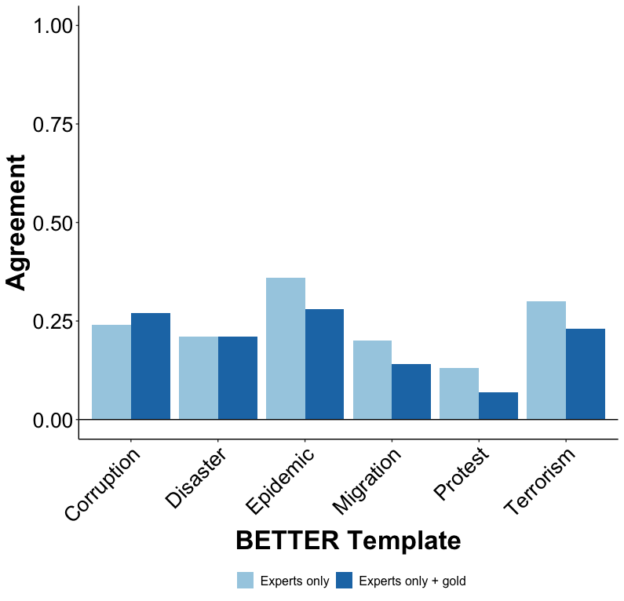
Gantt et al. 2023

Slide 86
Challenge
Difficult for annotators to agree on how many instances of a particular complex situation type are described by text.
Approach: Cross-document arg extraction*
Explicitly point to a complex situation description in one document and fill a template for it in another.
*Related to but distinct from similar tasks like Event Linking (Nothman 2012), Cross-Document Event Coreference (Bagga and Baldwin 1999, Cybulska and Vossen 2014, (Eirewetal.,2021,2022), and Predicate-Argument Alignment (Roth and Franke 2012, Wolfe et al. 2013, 2015).

Slide 87
Heavy Scaffolding
Cross-document argument extraction

Slide 88
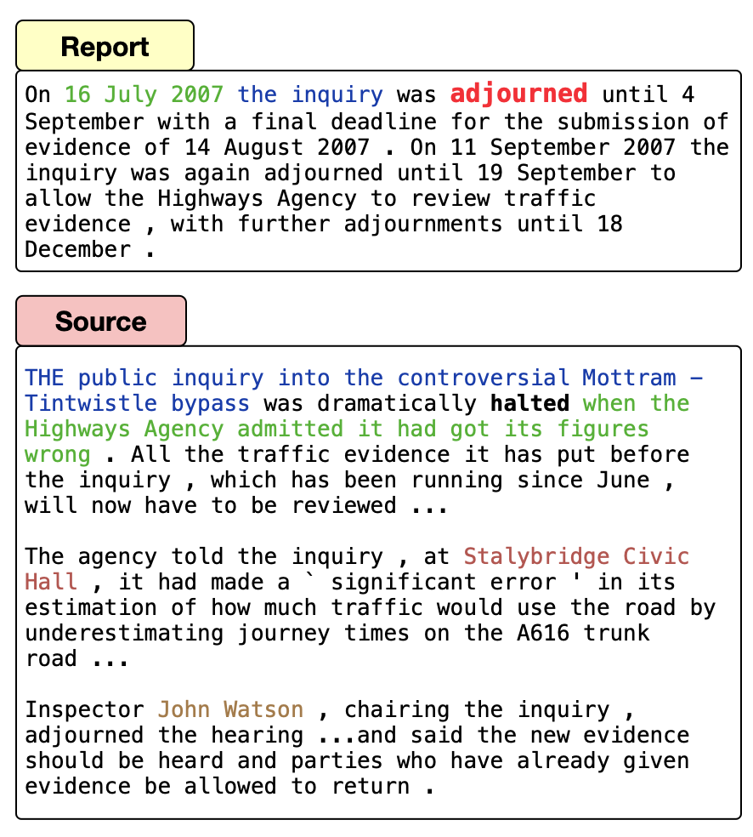
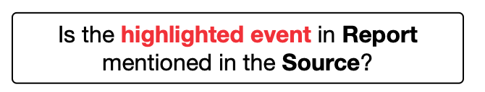
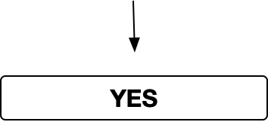
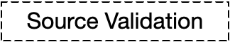
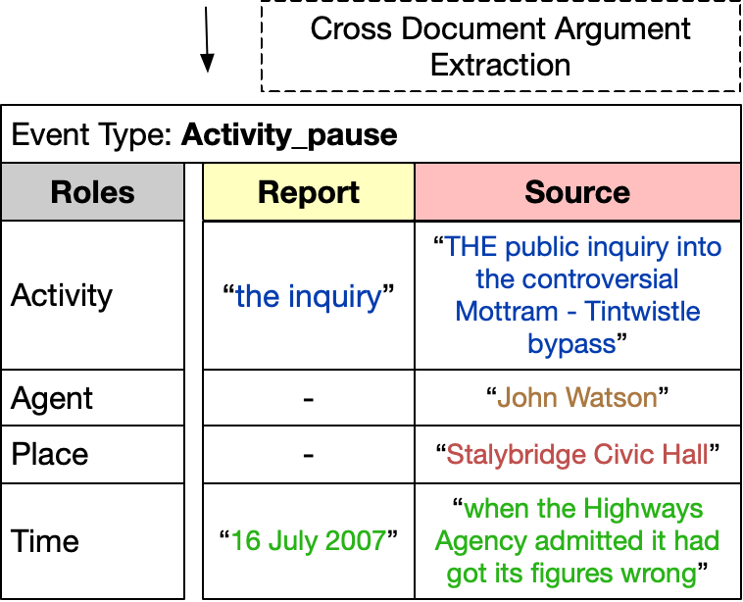
Data available at: https://github.com/FACTSlab/FAMuS
Vashishtha et al. 2023

Slide 89
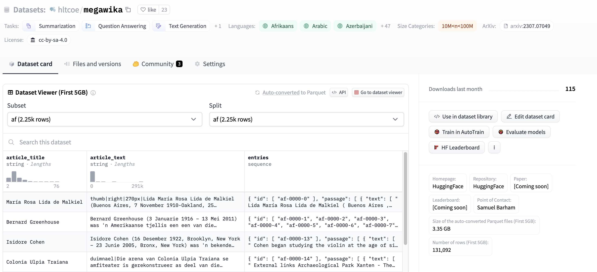
Base Corpus
Barham et al. 2023
MegaWika: >71 million source-report pairs over 50 diverse languages
Available at https://huggingface.co/datasets/hltcoe/megawika

Slide 90
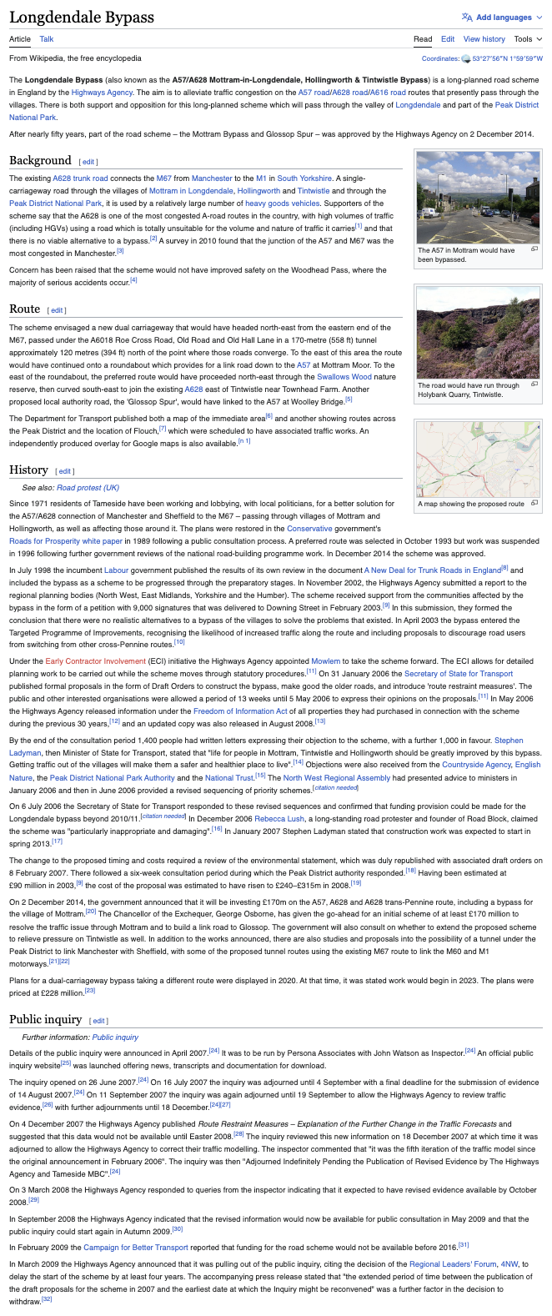
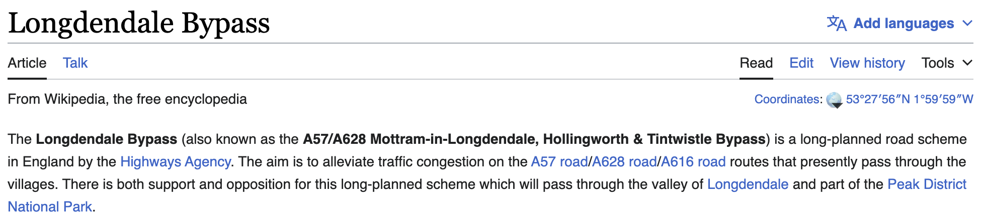
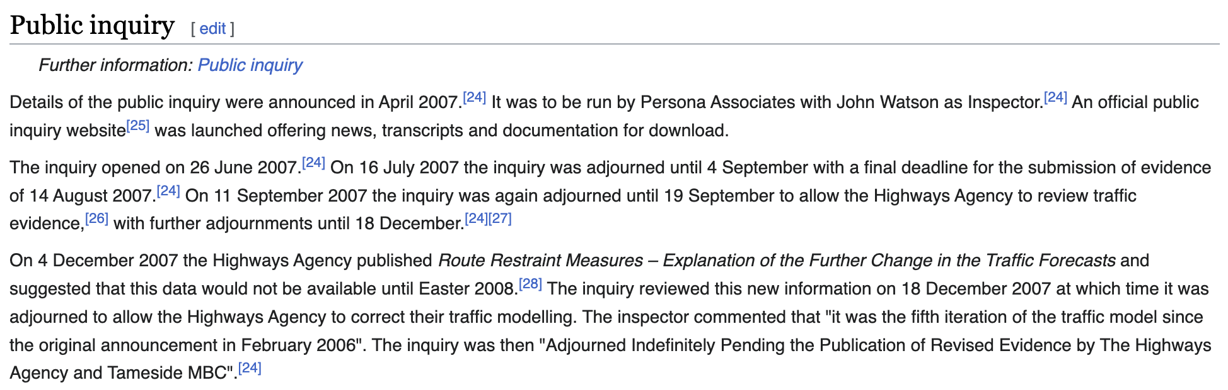
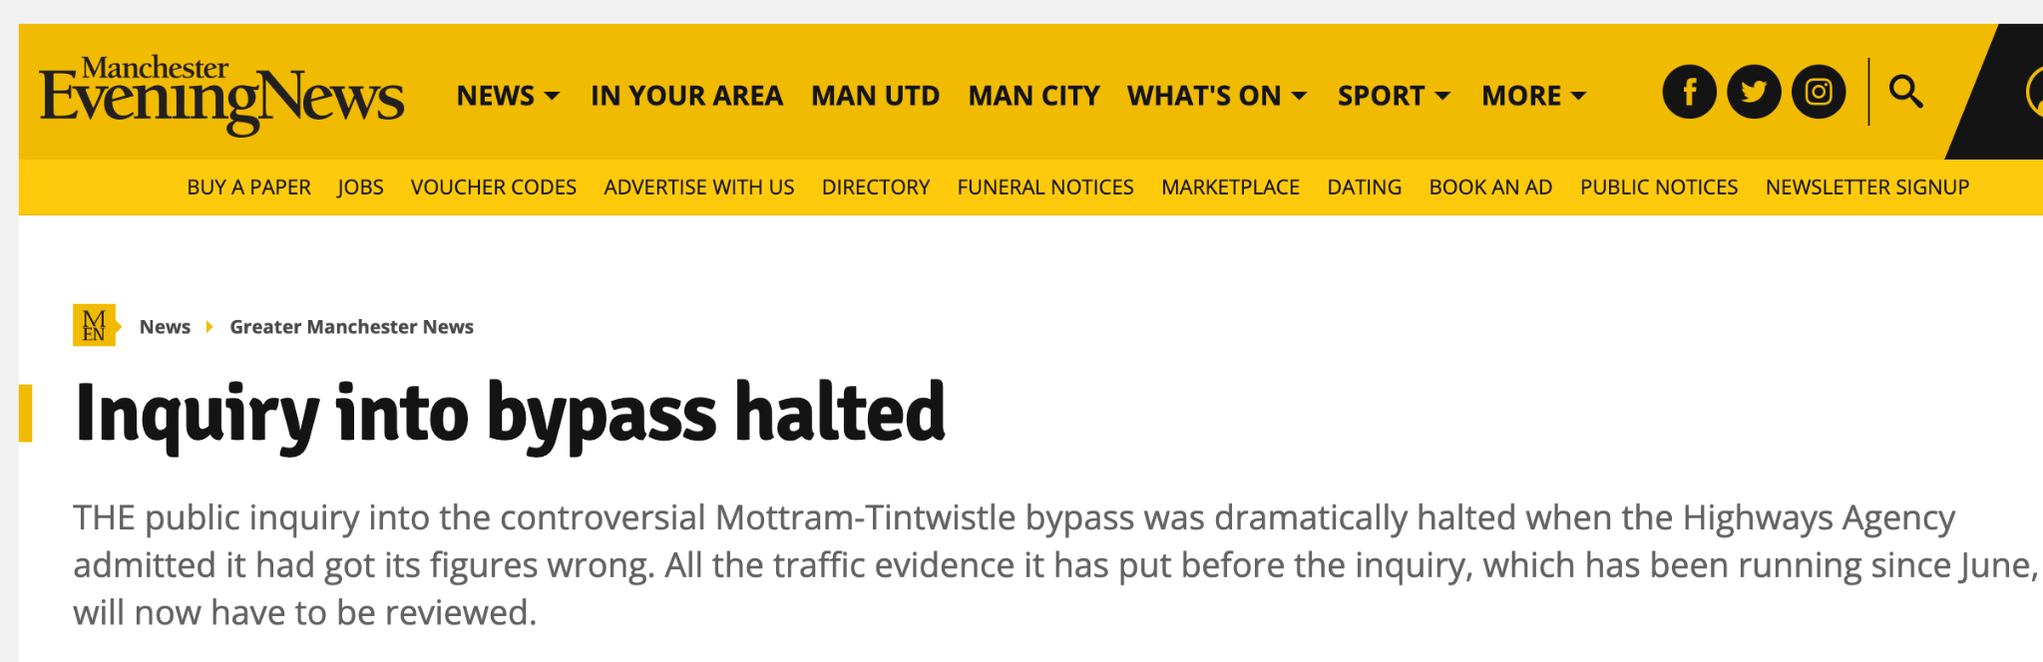
Barham et al. 2023

Slide 91
Corpus
Barham et al. 2023
MegaWika: >71 million source-report pairs over 50 diverse languages
Ontology
FrameNet as the underlying event ontology for broad-coverage of situation types (events, states, processes).
*Related to but distinct from similar tasks like Event Linking (Nothman 2012), Cross-Document Event Coreference (Bagga and Baldwin 1999, Cybulska and Vossen 2014, (Eirewetal.,2021,2022), and Predicate-Argument Alignment (Roth and Franke 2012, Wolfe et al. 2013, 2015).

Slide 92
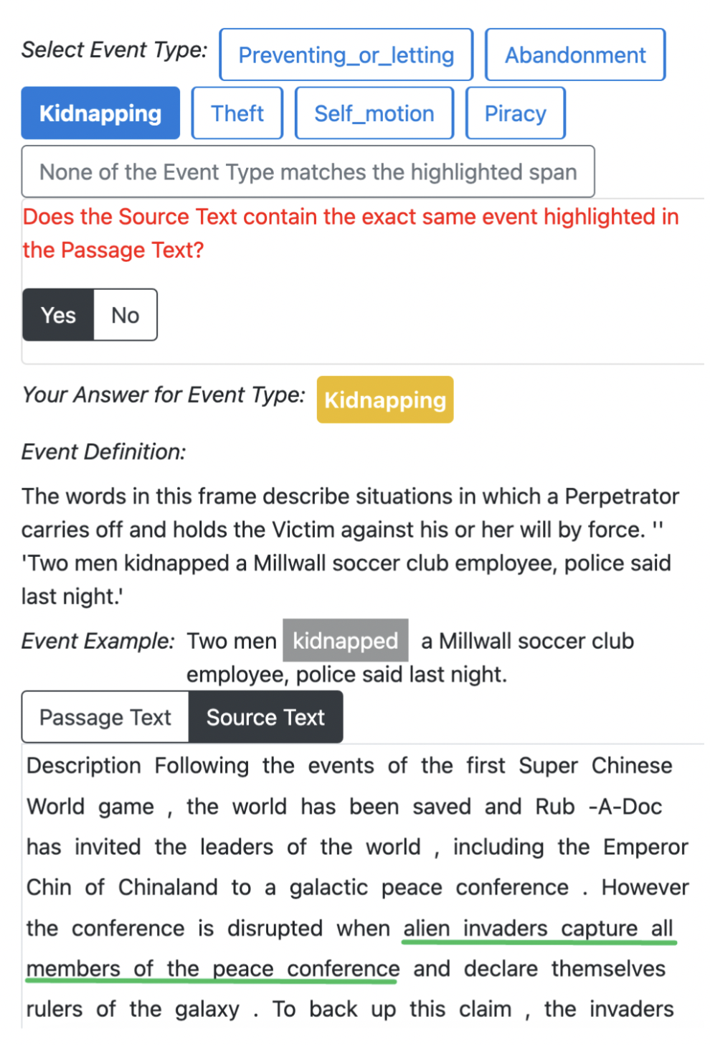
Source Validation
255 situation types from FrameNet
- 5 positive source validation (SV) examples for each event type - 5 negative source validation (SV) examples for each event type

Slide 93
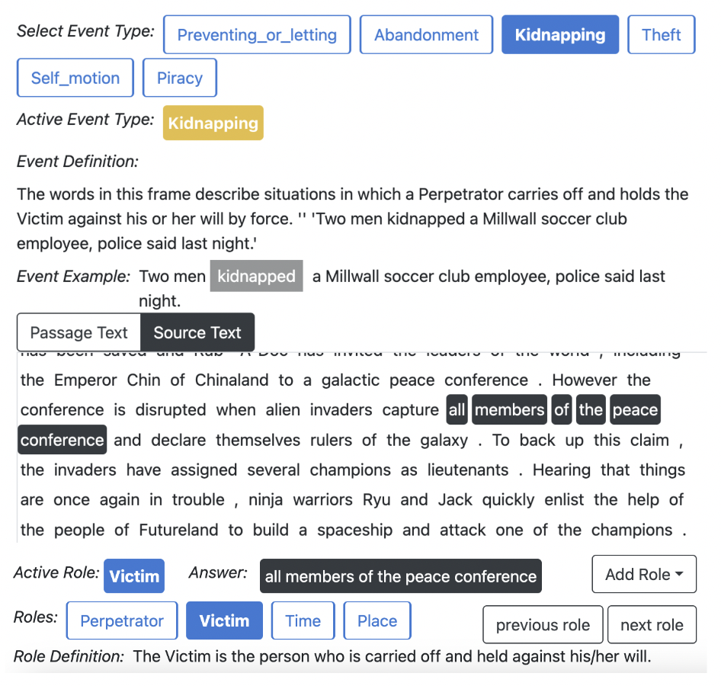
Cross-Document Argument Extraction
For each positive source validation, annotate roles in report and source.

Slide 94
Baselines: Source Validation
Lemma: target lemma is found in the source.
Longformer: document pair classifier
ChatGPT: prompt-based
Vashishtha et al. 2023

Slide 95
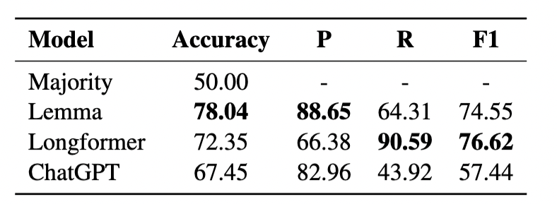

Slide 96
Baselines: Source Validation
Lemma: target lemma is found in the source.
Longformer: document pair classifier
ChatGPT: prompt-based
Baselines: Cross-Doc Argument Extraction
Report: ignore the source and use spans from report
IterX: structured prediction model
Longformer-QA: fine-tuned QA model
ChatGPT and Llama2: few-shot prompting models
Vashishtha et al. 2023

Slide 97
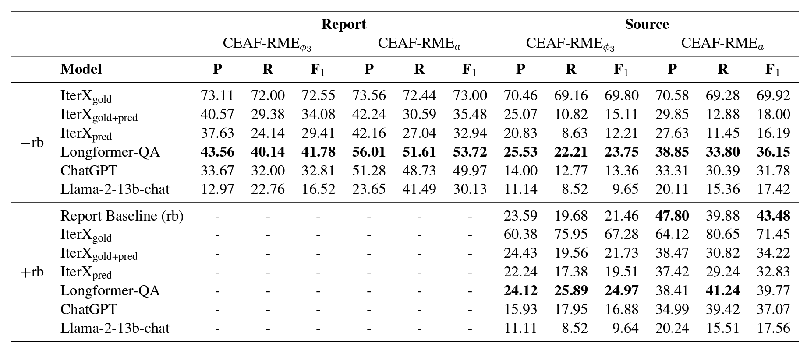
This task is hard for all models.

Slide 98
Conclusion

Slide 99
Question
How do we design systems that capture the inferences we draw about situations based on their descriptions?
Ontology-factored approach
Map situation description to symbolic situation ontology and draw inferences using rules stated over that ontology.
Ontology-free approach
Map situation descriptions to natural language strings expressing the inferences of interest.

Slide 100
Challenge #1: Expense
Ontologies and annotated corpora are expensive to build and maintain because they require highly trained experts.
Challenge #2: Brittleness
Ontologies do not easily capture the ways in which context modulates the inferences that we draw.

Slide 101
Challenge: Lack of Abstraction
Not clear how to determine an interesting set of inferences with which to represent a situation.

Slide 102
Ontologies as Representational Scaffolding
Ontologies provide guidance about what the interesting, more abstract inferences are.
These more abstract inferences are directly associated with a text, as in ontology-free approaches.

Slide 103
Part 1: Light Scaffolding
Highly abstract ontologies as light scaffolding for building sets of broadly applicable inference templates.
Part 2: Heavy Scaffolding
More concrete ontologies as heavy scaffolding for building sets of more targeted inference templates.

Slide 104
Future Directions
Improve performance of cross-document argument extraction systems as a means to guide targeted inference selection for downstream annotation.

Slide 105
Thanks!
Supported by NSF-BCS-2040831 (Computational Modeling of the Internal Structure of Events), University of Rochester, JHU HLTCOE, DARPA AIDA, DARPA KAIROS, and IARPA BETTER.

Slide 106
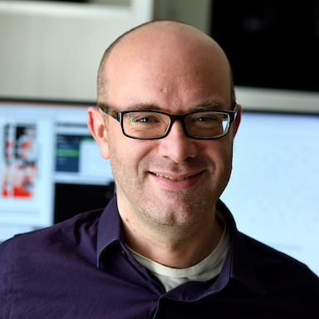


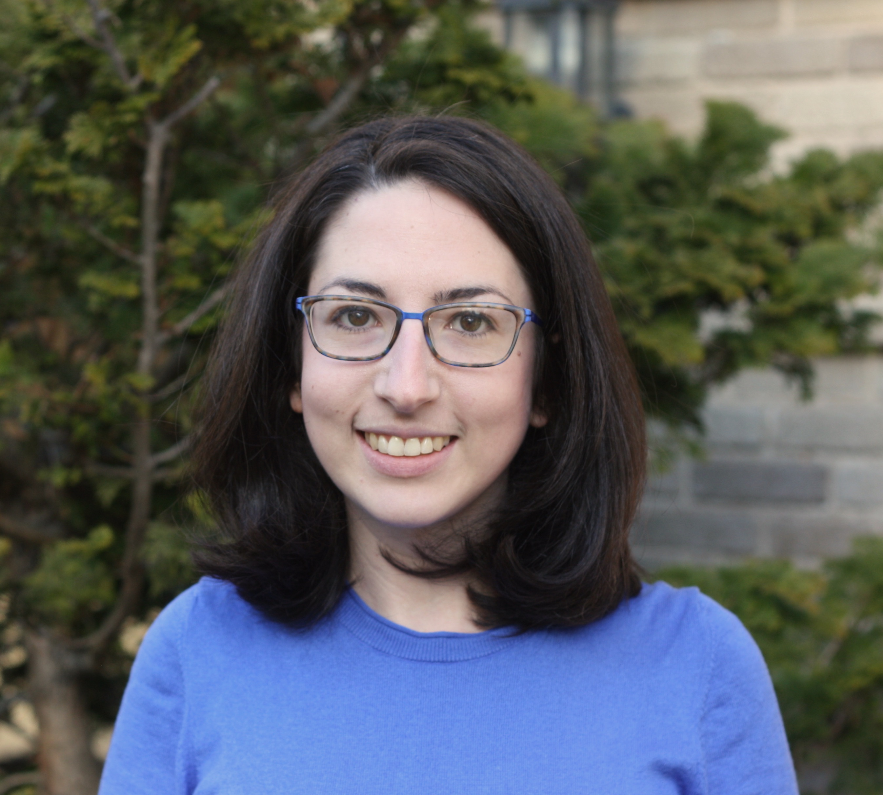
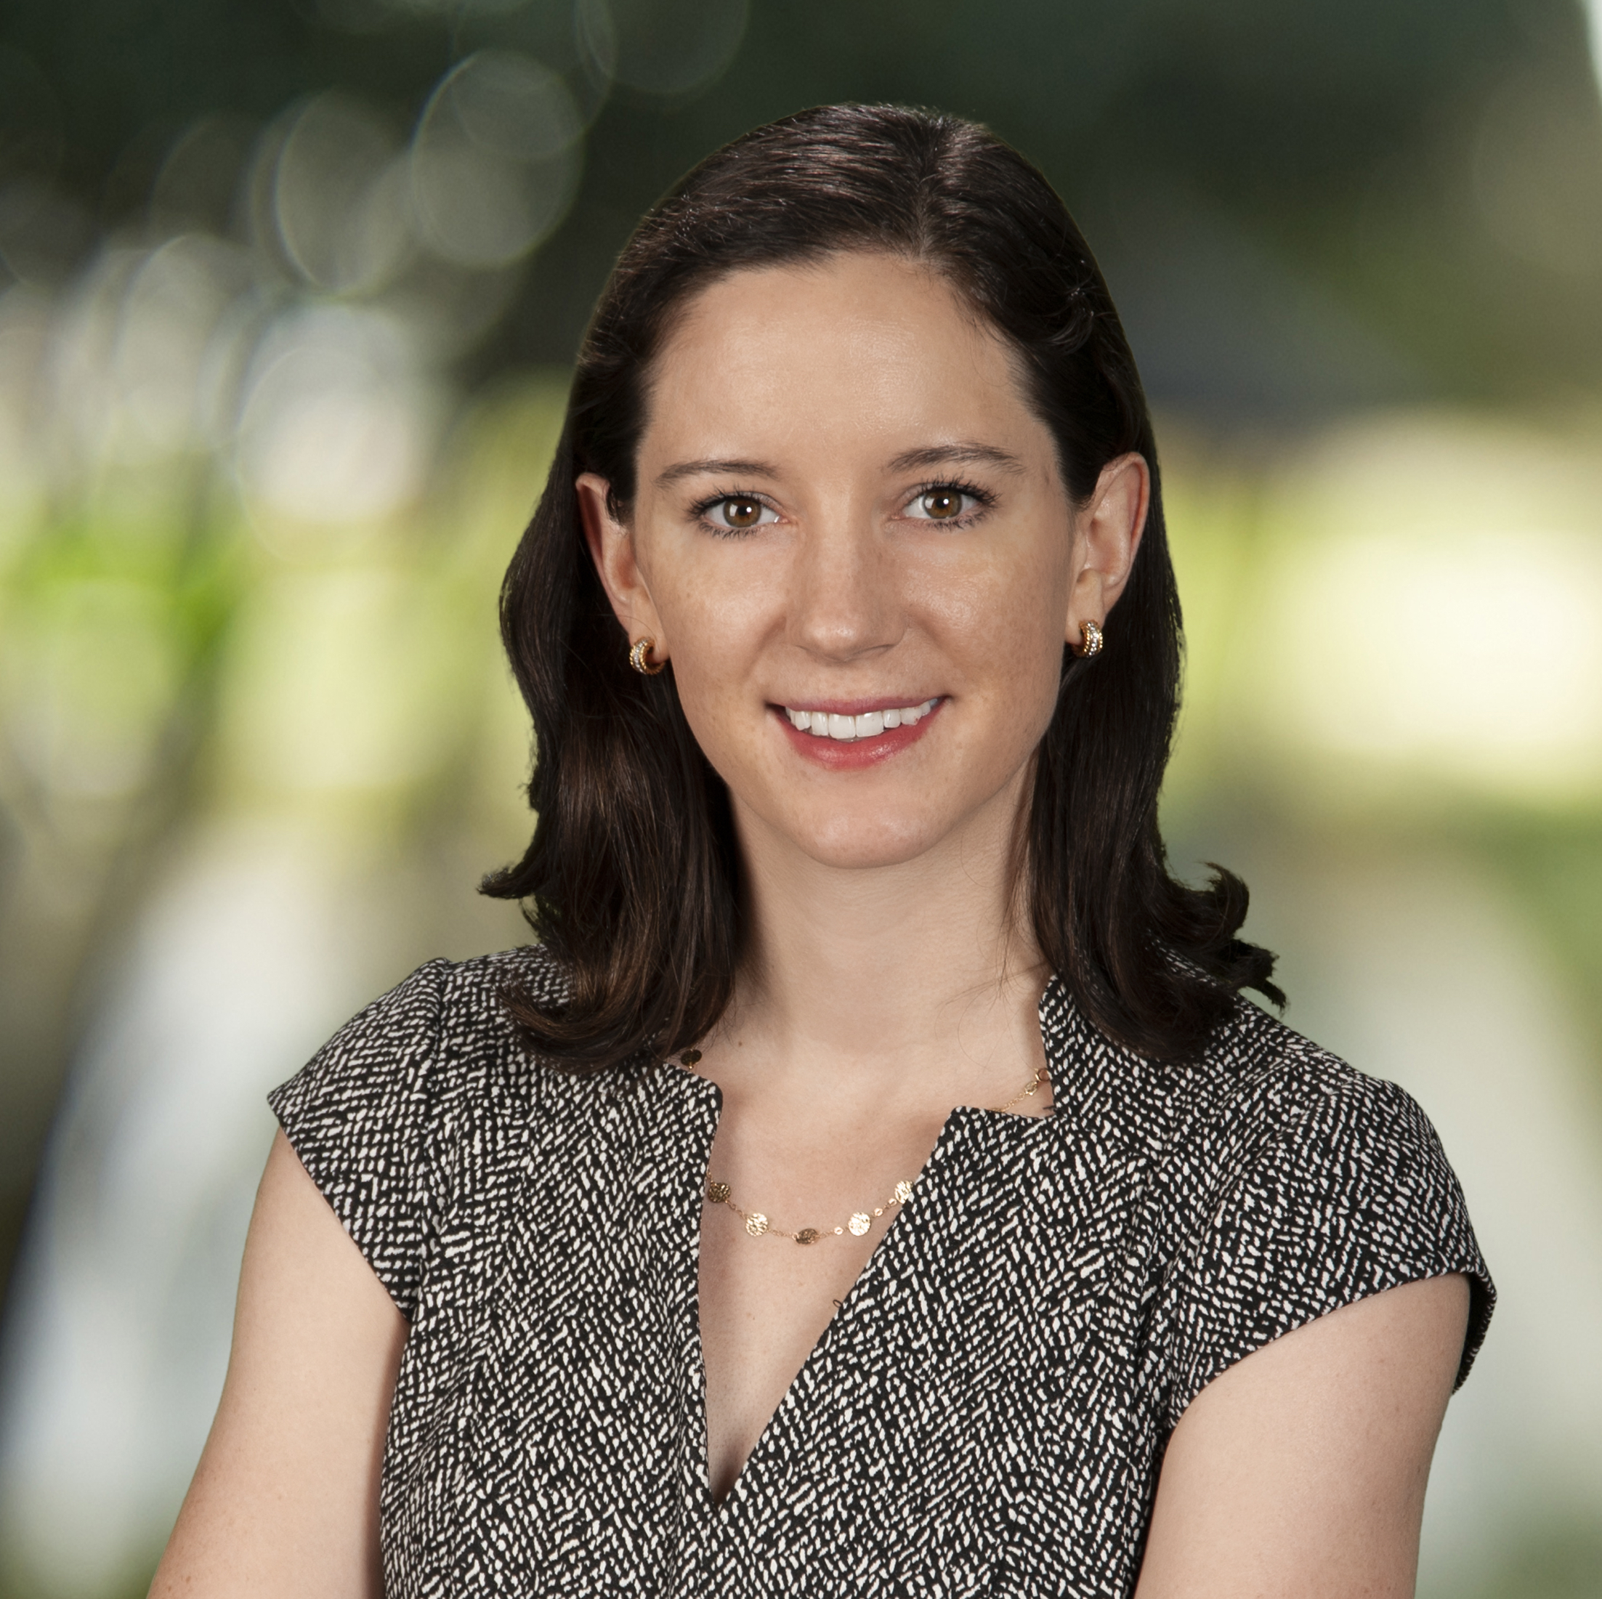
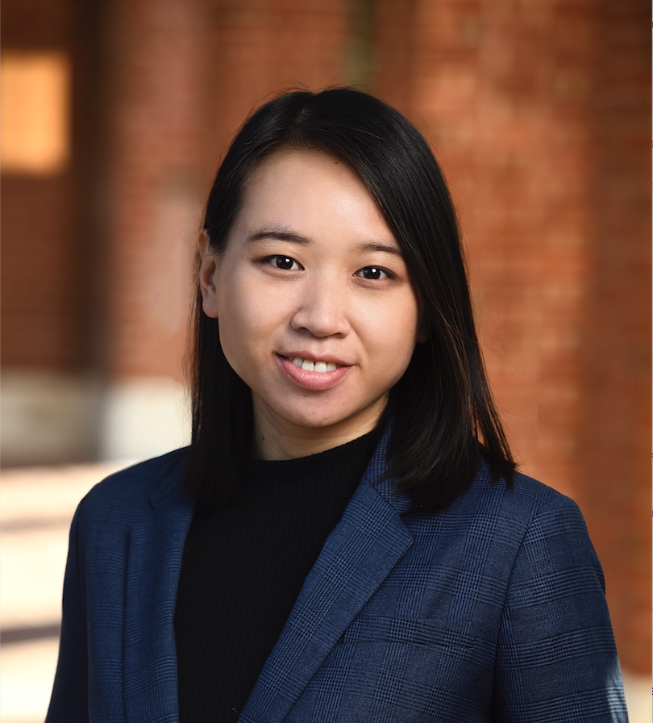




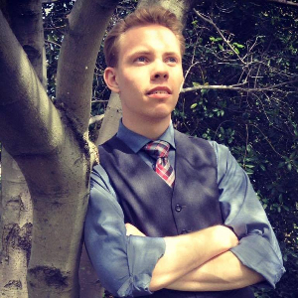
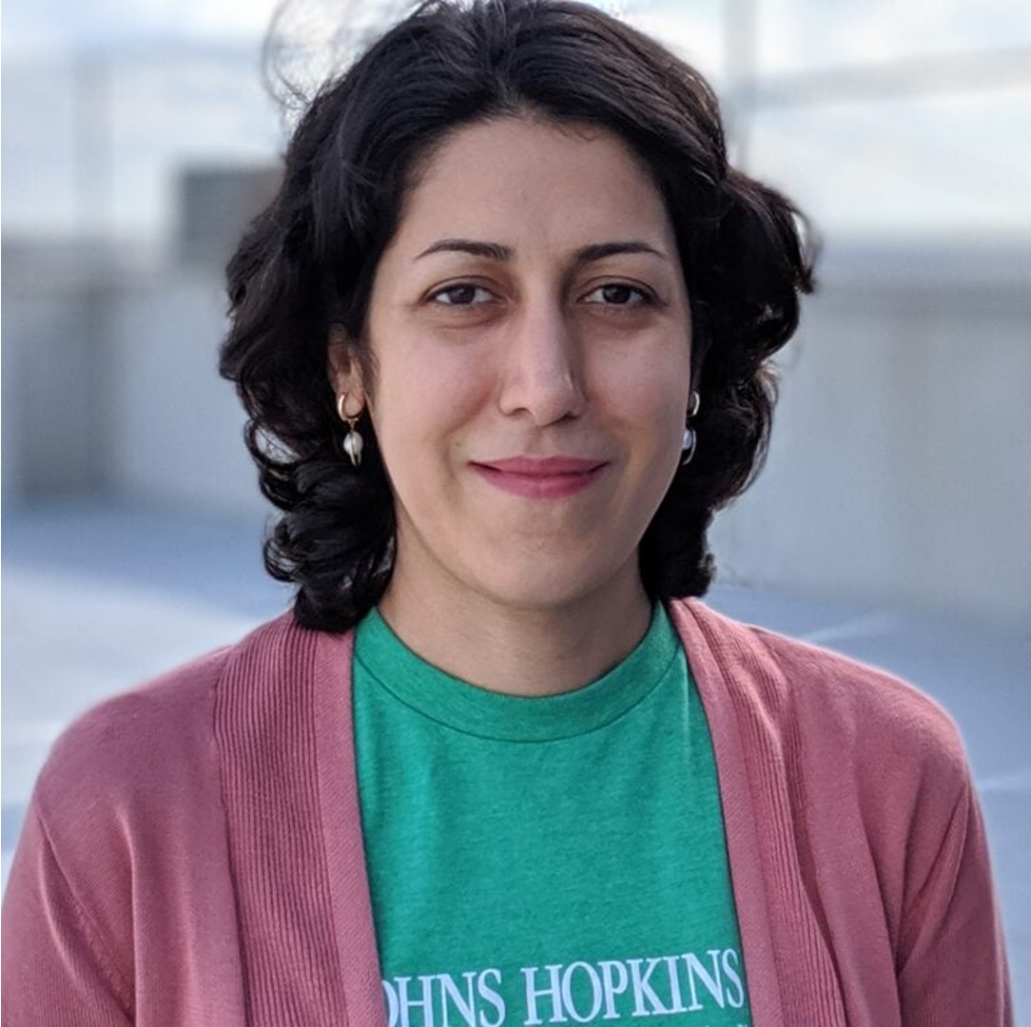
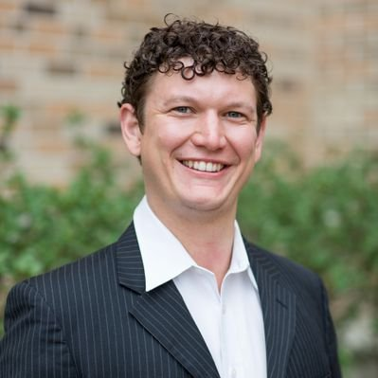





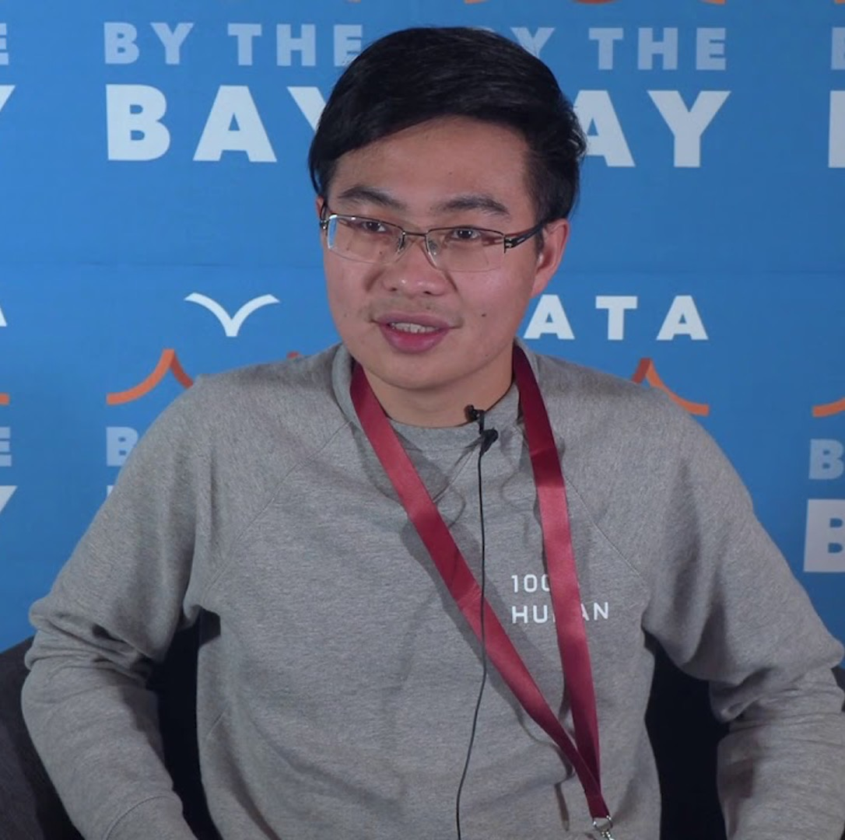

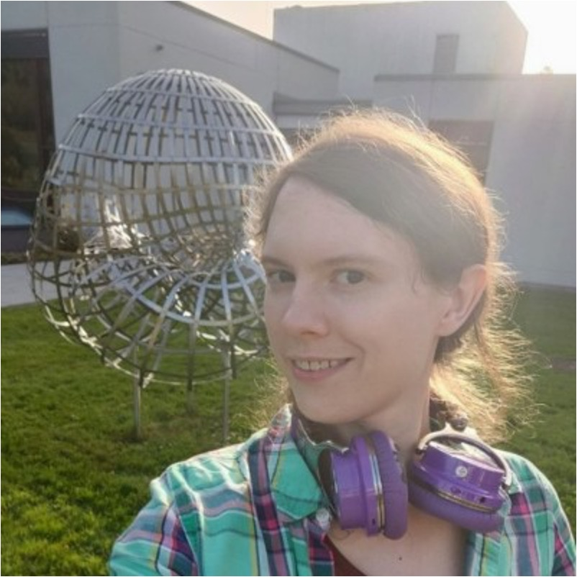
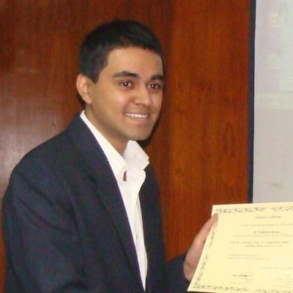





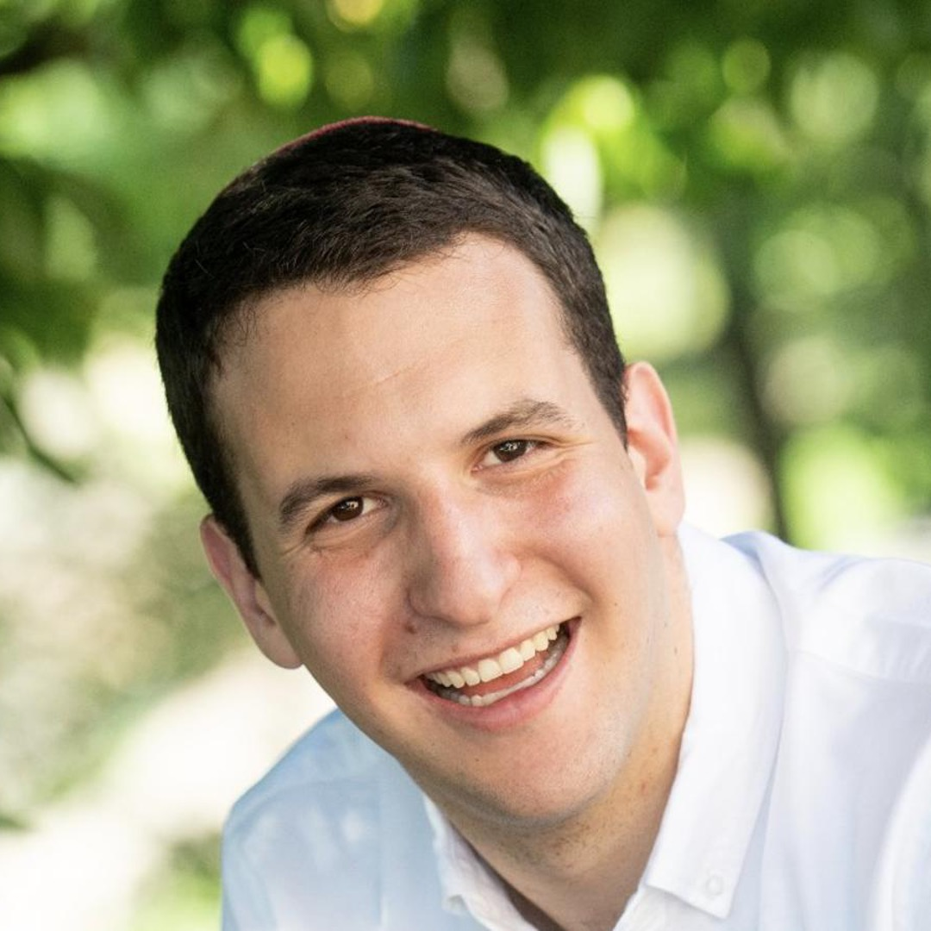
Kyle Rawlins
JHU
Ben Van Durme
JHU
Jordan Boyd-Graber
UMD College Park
Rachel Rudinger
UMD College Park
Lelia Glass
Georgia Tech
Anqi Liu
JHU
Kevn Duh
JHU
Sid Vashishtha
Rochester
Will Gantt
Rochester
Yunmo Chen
JHU
Sam Barham
JHU
Mahsa Yarmohammadi
JHU
Kenton Murray
JHU
Reno Kriz
JHU
Arsal Imtiaz
Everlaw
Chandrashekar Nair
Everlaw
Alex Martin
Rochester
Weiwei Gu
ASU
Tongfei Chen
Microsoft
Venkat Govindarajan
UT Austin
Dee Ann Reisinger
Bryn Mawr
Pushprendre Rastogi
DeepMind
Elias Stengel-Eskin
UNC Chapel Hill
Sheng Zhang
Microsoft
Zhengping Jiang
JHU
Orion Weller
JHU
Michelle Yuan
UMD College Park
Adam Poliak
Barnard

